Slide 1
Presentation
Jiayu Chen
2024.01.15

Slide 2
Work Description
Part_1: Detailed Introduction to the BSG Signal Processing Workflow:
Signal Preprocessing
Segmentation and Realignment
Template Calculation and Quality Assessment
Feature Extraction
Prediction
Part_2: Attempts based on the given suggestions, including Matched Filter, SG Filter, and differentiation
Part_3: A Brief Explanation of the FMM Algorithm
Part_4: Problems
Notes:
第一部分是详细介绍BSG信号处理的工作流。里面总结了以往重要的进展，以及最新的一些进展。给Song老师回顾一下，Song Yingjian学长你也可以知道我到底做了什么.
第二部分是根据song老师你给我的提示，我都进行了尝试，然后尝试的结果给你一个反馈

Slide 3
Part_1

Slide 4
Signal Preprocessing
Preprocessing
Segmentation
Realignment
Template
Feature Extraction
Prediction
Problem_1: Filter out signals of poor quality
Problem_2: How to deal with the breathing?
Previous
Codes: Implemented by myself from the paper IoT2023
Standard: The strategy is too strict.
Result: 4672 -> 472
Now
Codes: Provided by Yingjian
(BCG_Preprocessing.py)
Standard: The strategy is different from the paper, being more lenient.
Result:4672 -> 4524
Simulated SCG | Method | S | D
No RR/With RR | No Template | 0.79/0.91 | 1.79/3.38
No RR/With RR | Mean | 1.35/1.20 | 4.53/4.81
No RR/With RR | DBA | 2.05/1.73 | 3.43/3.13
The impact of breathing on the amplitude of peaks in the template can be mitigated by using an appropriate averaging algorithm (DBA).
Time Series Averaging has been proven to be an NP-Complete problem, and DBA algorithm functions as an approximation to compute a local optimal solution on the gradient.
Why the algorithm can eliminate the influence of breathing might be explained intuitively clear.
It is necessary to establish appropriate criteria and then add another round of filtering to ensure the quality of signals.
The criteria for this filtering have been found. Details will be provided later.
Notes:
之前的通过手动复现论文“”实现了信号质量检测
论文中给出的策略有一些过于严格了，筛选完信号只剩下十分之一，
然后拿到了Yingjian学长的源代码。质量评估函数的评估策略相比与论文里的要宽松不少，4672信号还剩下4524条信号。
我现在全面采用了Yingjian的预处理方式。
提取模板用的信号，比预测心跳用的信号，有着更高的质量要求。
我和Song老师在上次会议时认为，需要确立合适的标准，再增加一轮筛选，从而确保信号的质量。
这个筛选的标准，已经解决了，我后面会详细的说

Slide 5
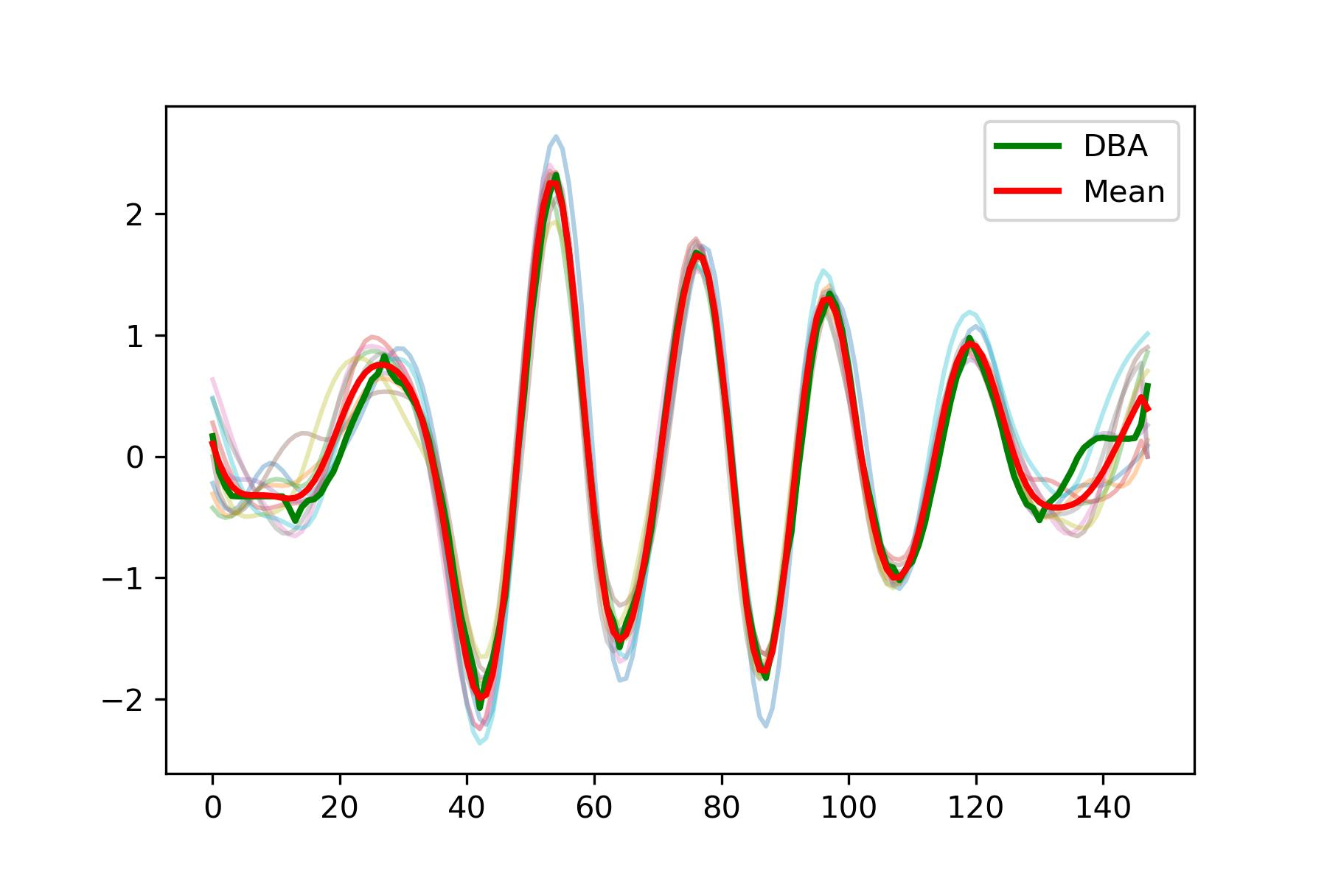
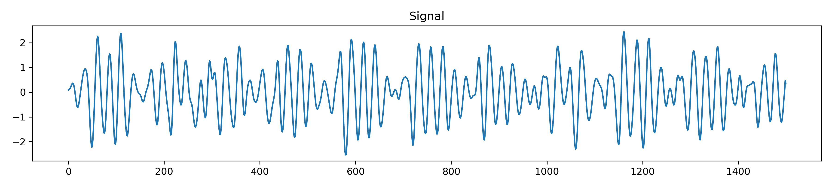
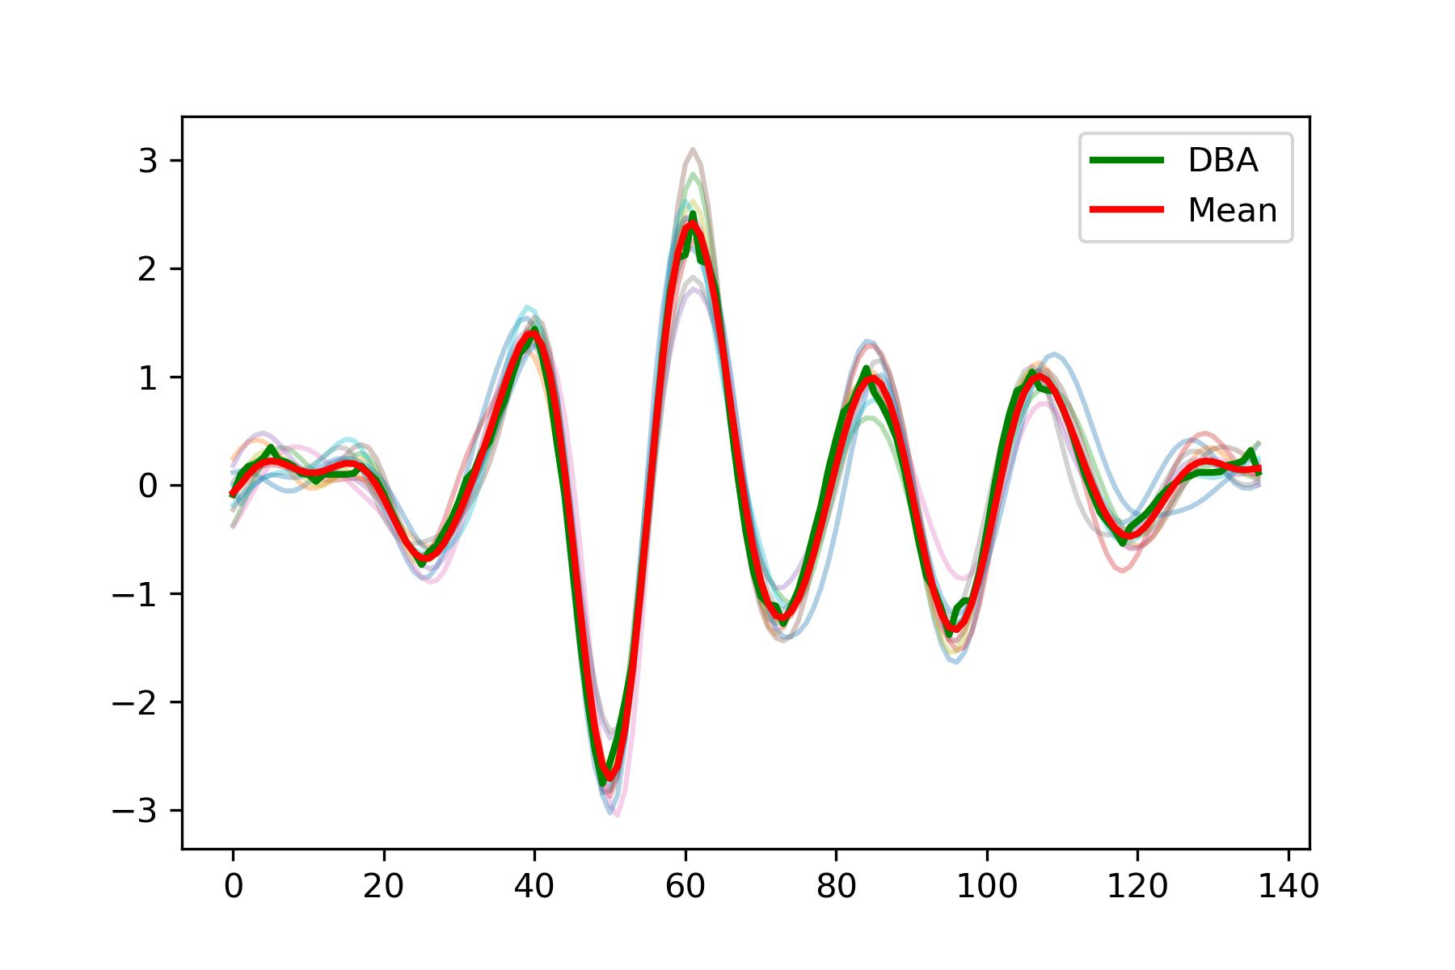
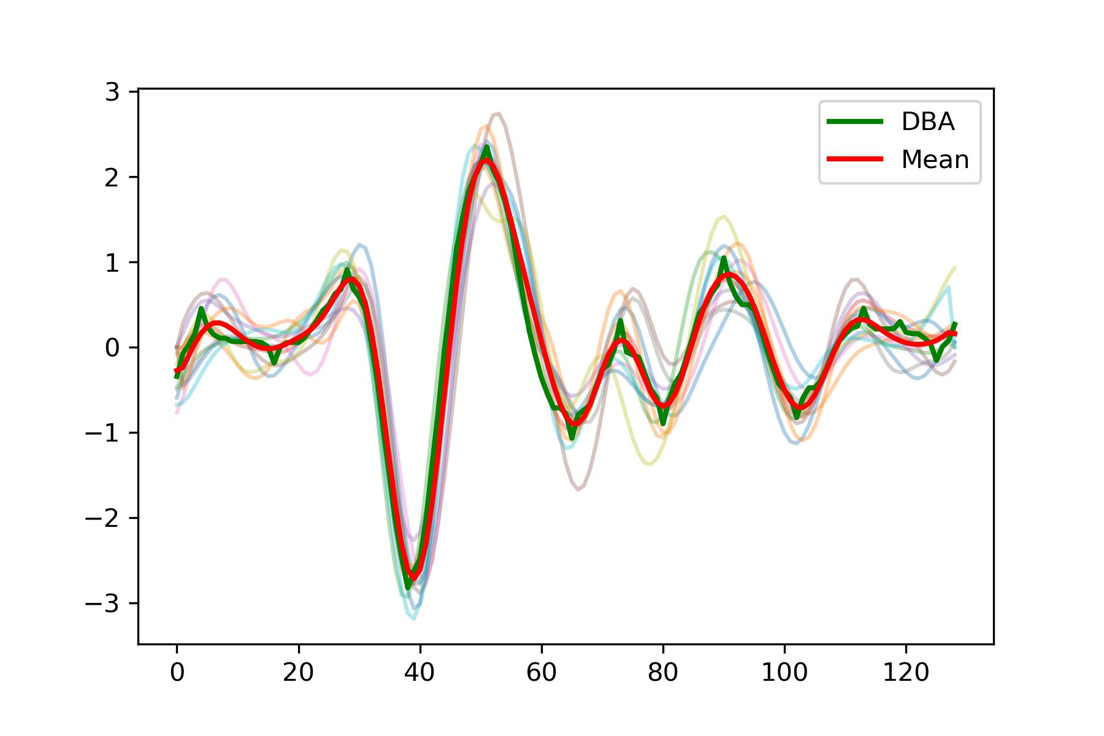
Segmentation
Preprocessing
Segmentation
Realignment
Template
Feature Extraction
Prediction
Challenges encountered in BSG signals are as follows
Compared to simulated SCG signals, The initial section of the signal is often problematic, with periodic incompleteness.
Waveforms sometimes resemble SCG, sometimes resemble BCG, and occasionally fall between the two.
BSG Signals are multi-peaked, and the amplitudes of peaks within each cycle are not consistent. Unlike SCG or ECG signals, there is no fixed main peak.
BCG
SCG

Slide 6
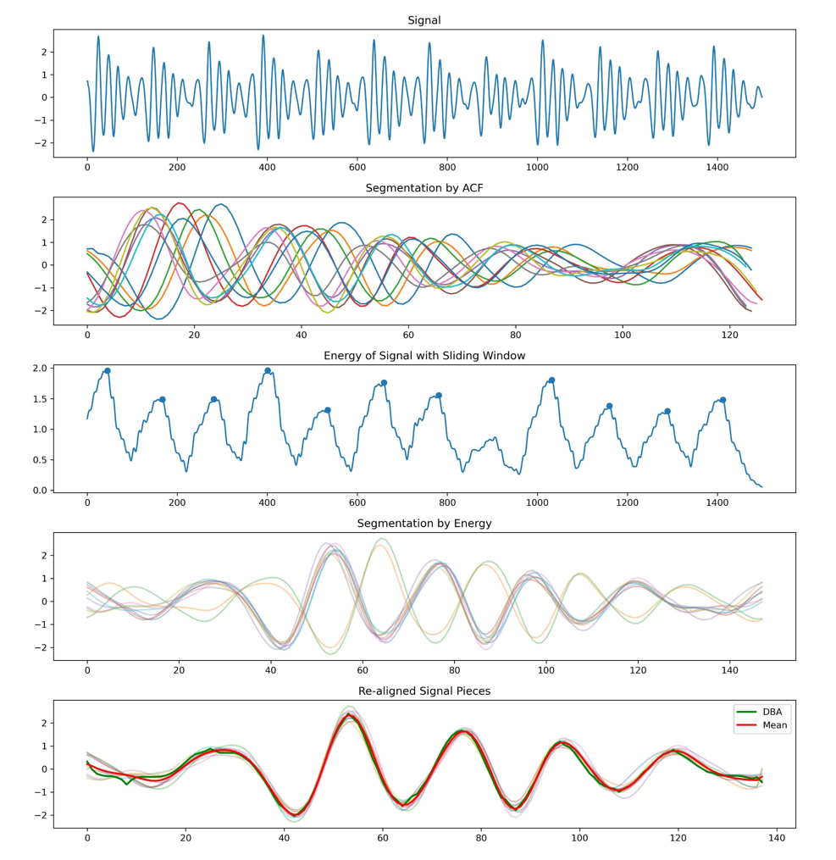
Segmentation
Preprocessing
Segmentation
Realignment
Template
Feature Extraction
Prediction
I attempted to extend an approach presented by Yingjian Song in IoT2023.
While this method is sufficient for estimating heart rate, it is not adequate for accurate segmentation, leading to the following two issues:
Significant and unmanageable errors, making alignment difficult.
The resulting segments are not the desired cycles after the split.
Signal
Hilbert transform for envelope
ACF
Peak Detection
We get
Savitzky-Golay filter
Segmentation
We want

Slide 7
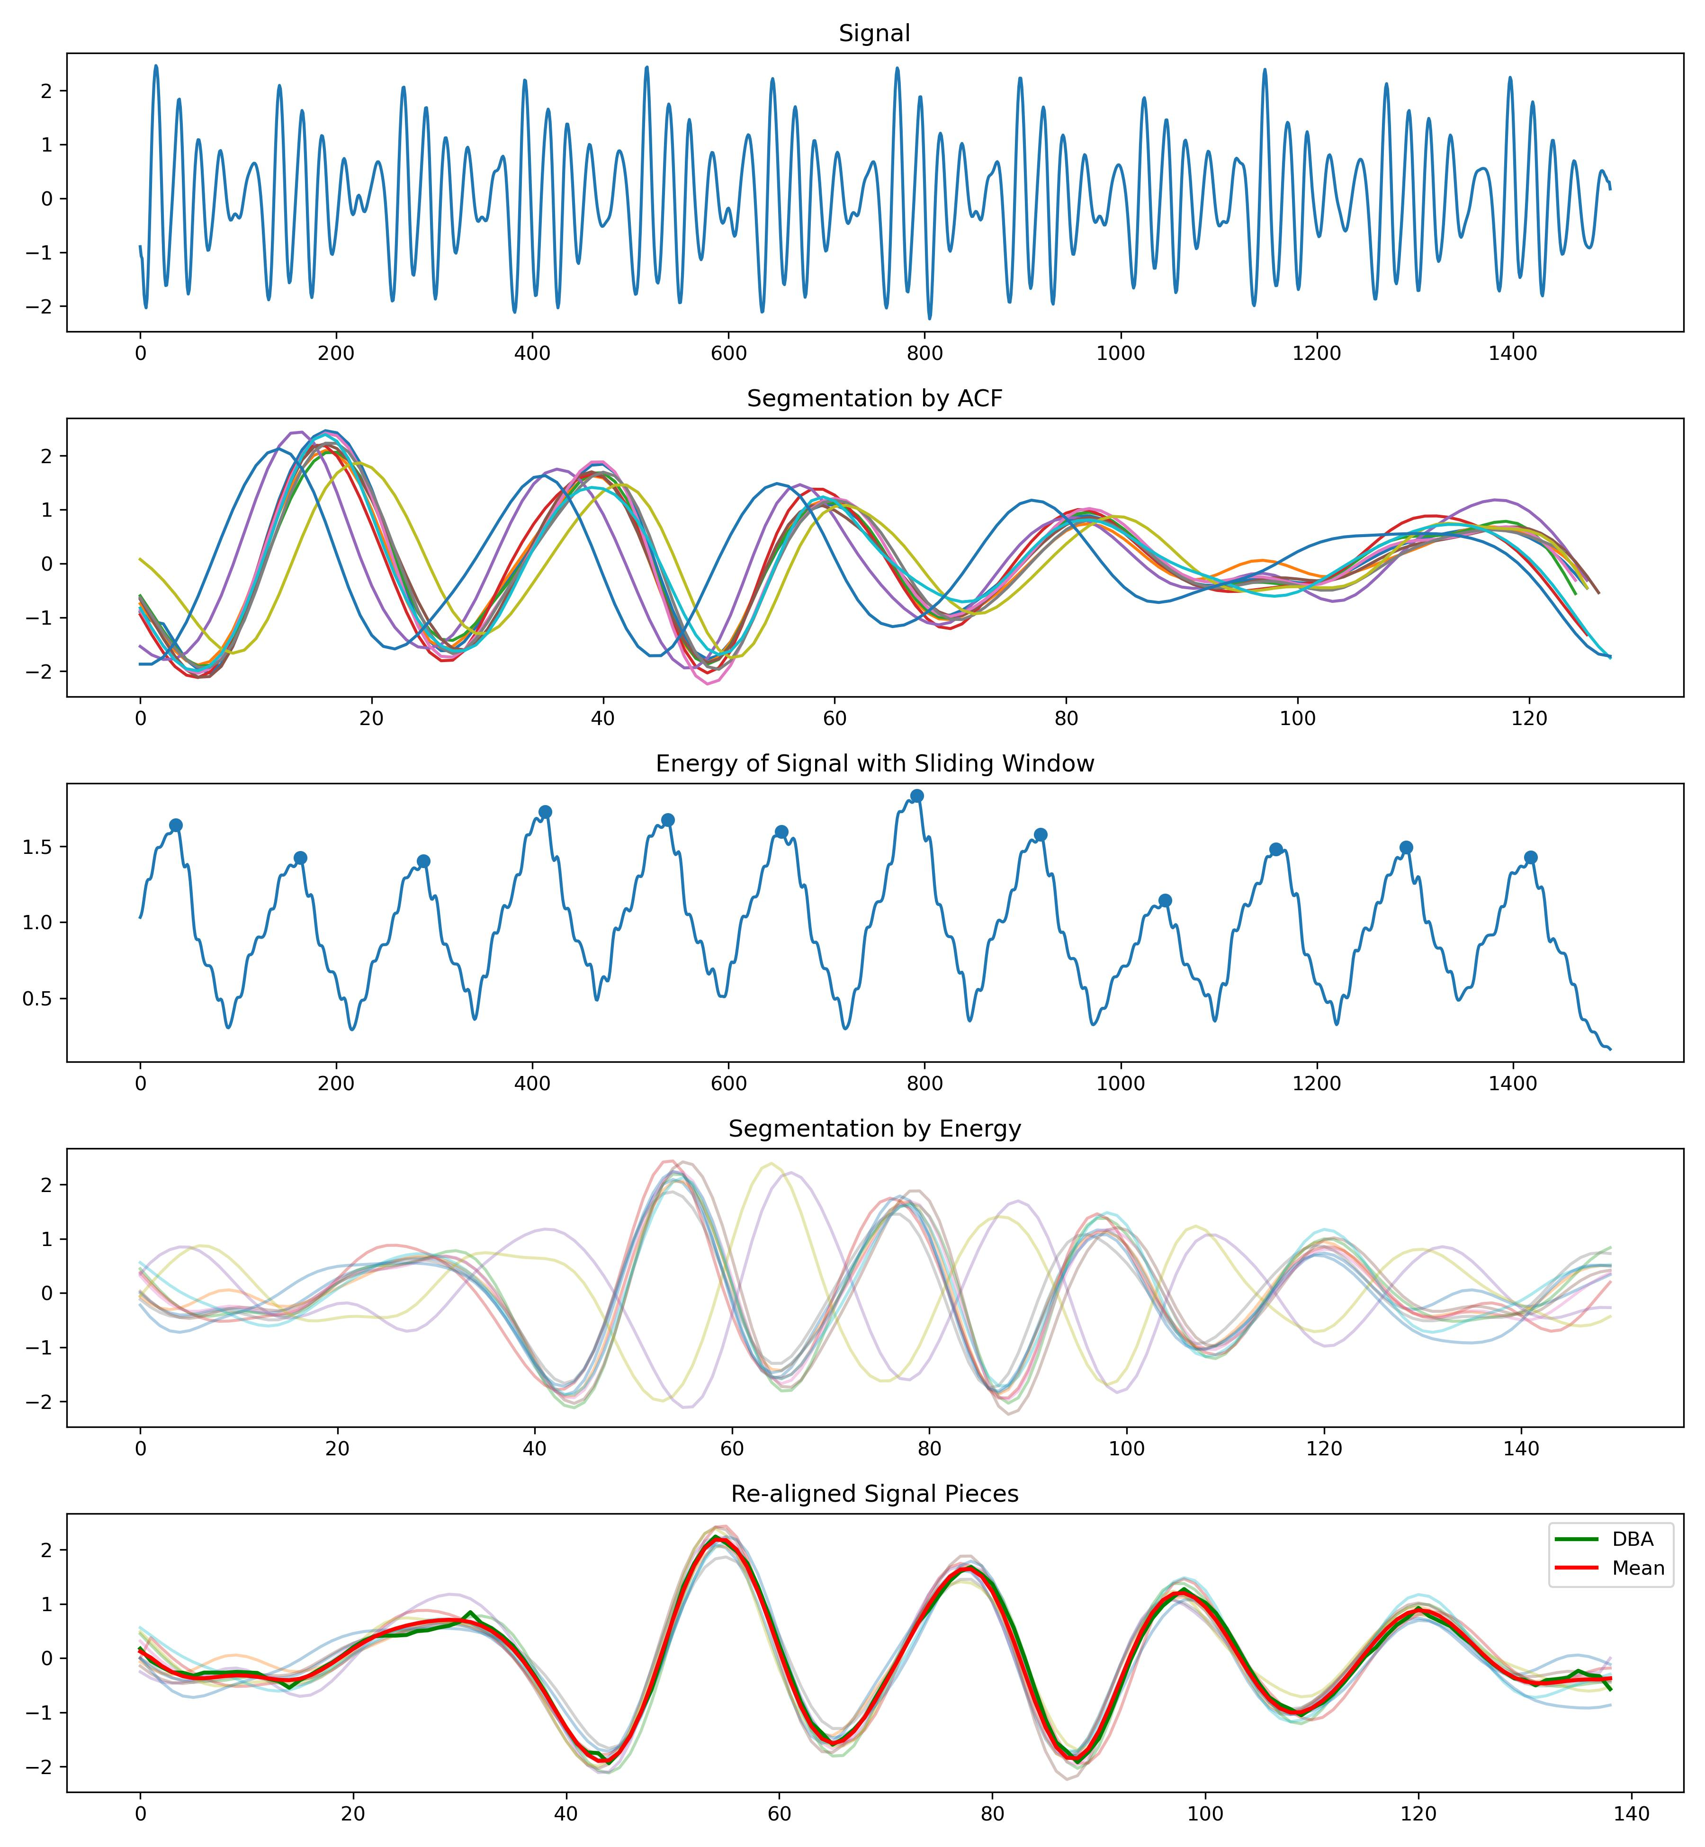
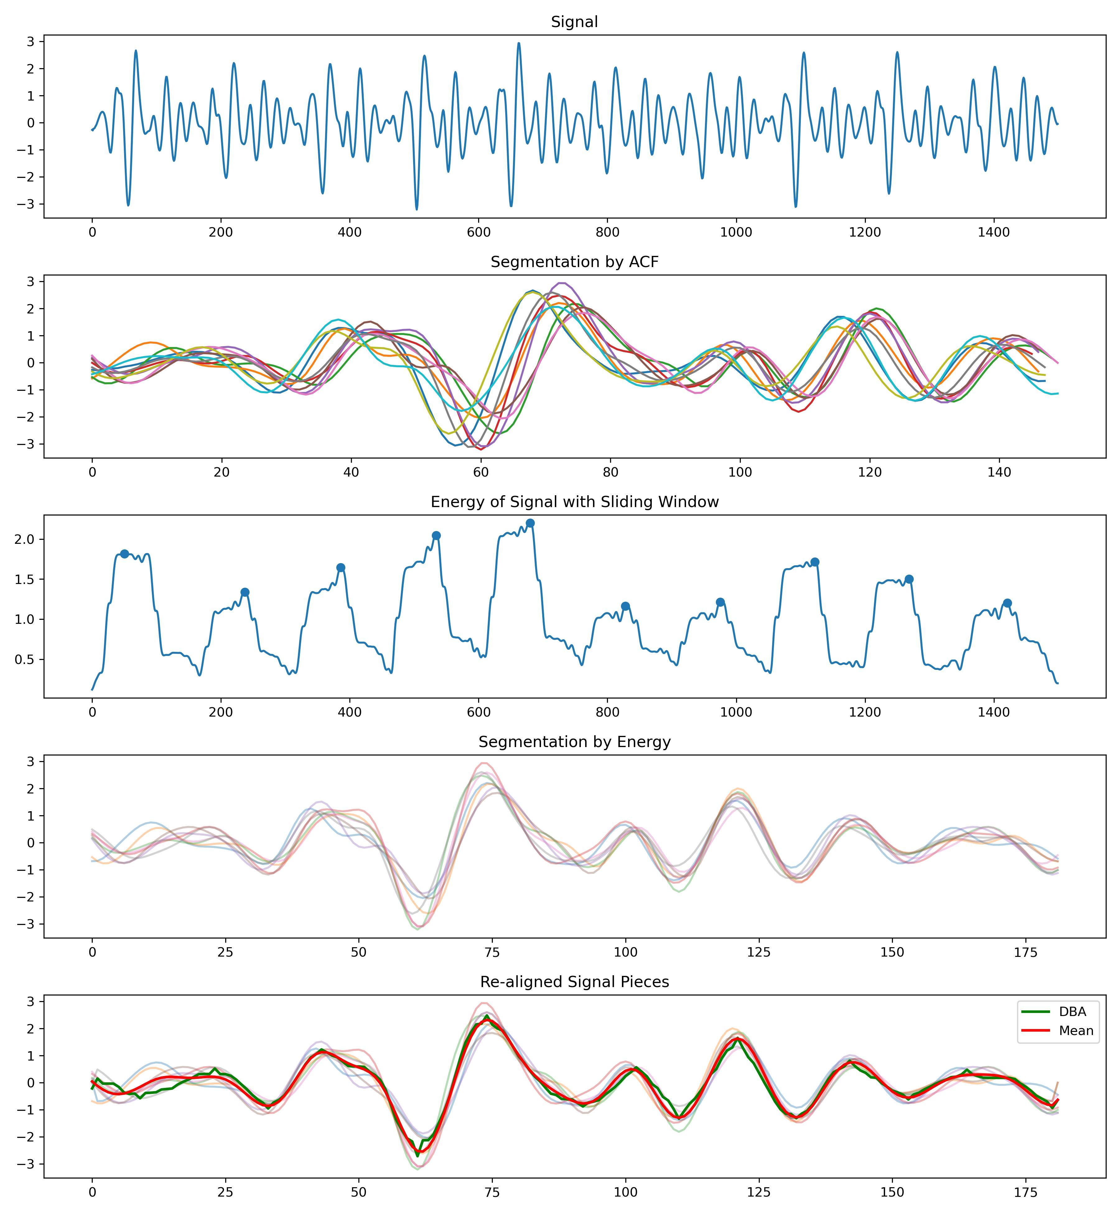
Segmentation
Preprocessing
Segmentation
Realignment
Template
Feature Extraction
Prediction
Solution approach:
Transform the multi-peak signal in time domain into a single-peak problem in another domain, and ensure that this single peak is relatively fixed within each cycle.
Upon observation, the distribution of energy density within a single cycle of the signal is often relatively stable.
Transforming the multi-peak signal in the time domain into a single-peak problem in the energy density domain.
Notes:
计算能量密度包络线，并对这个包络线寻找峰值，从而依据这个峰值对信号进行分割

Slide 8
Re-alignment
Preprocessing
Segmentation
Realignment
Template
Feature Extraction
Prediction
The distribution of energy density is often relatively stable, but not completely identical.
To enhance precision, it is necessary to re-align the signals that have already been segmented.
Linear Alignment -> O(T)
Linear Realignment
Acceptable
Without phase variation
Non-Linear Alignment -> O(T^2)
One-circle pieces
With phase variation
Non-Linear Realignment
Unacceptable
There is no need for us.

Slide 9
Re-alignment
Preprocessing
Segmentation
Realignment
Template
Feature Extraction
Prediction
Start
Choose one piece x from N pieces X
Cross Correlation between x and X[1]
Cross Correlation between x and X[N-1]
Add the Cross Correlation results from N-1 times
Find the appropriate time unit for lag.
Time complexity O(N^3), where N represents the average length of a single cycle.
This algorithm is guaranteed to converge.
Realign piece x.
Re-aligned pieces
Notes:
假设把一段十秒的信号切分成了10个周期，10个片段。
从中按照顺序取出一个周期，分别计算该周期与剩下9个片段的互相关系数，然后相加。
这样，最大峰所在的位置，就是这个周期在时间轴上平移的距离
循环往复，就可以得到被重新对齐好的片段了。

Slide 10
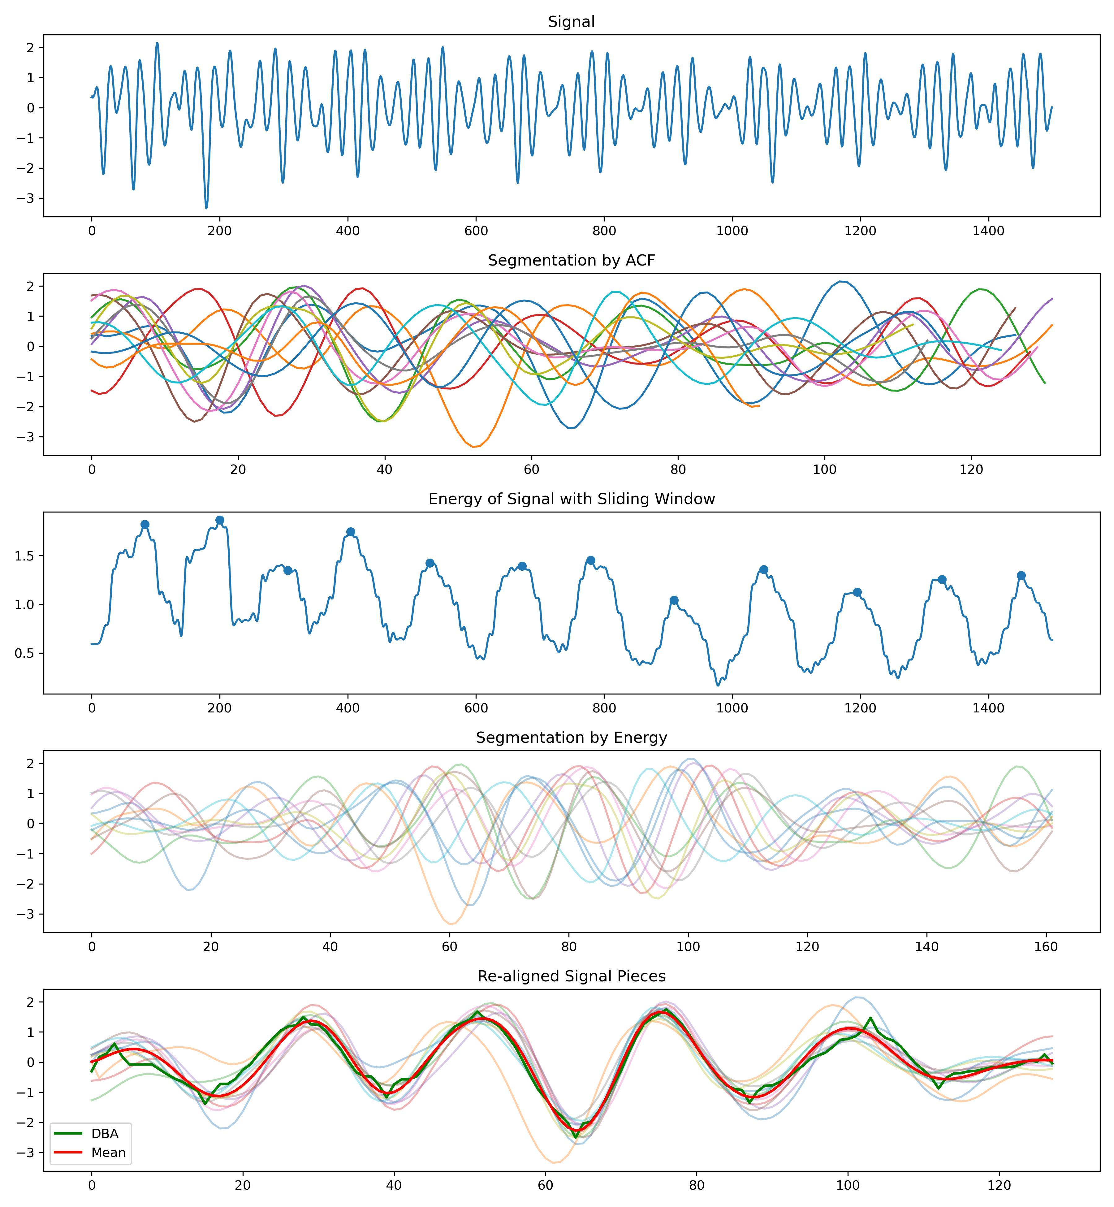
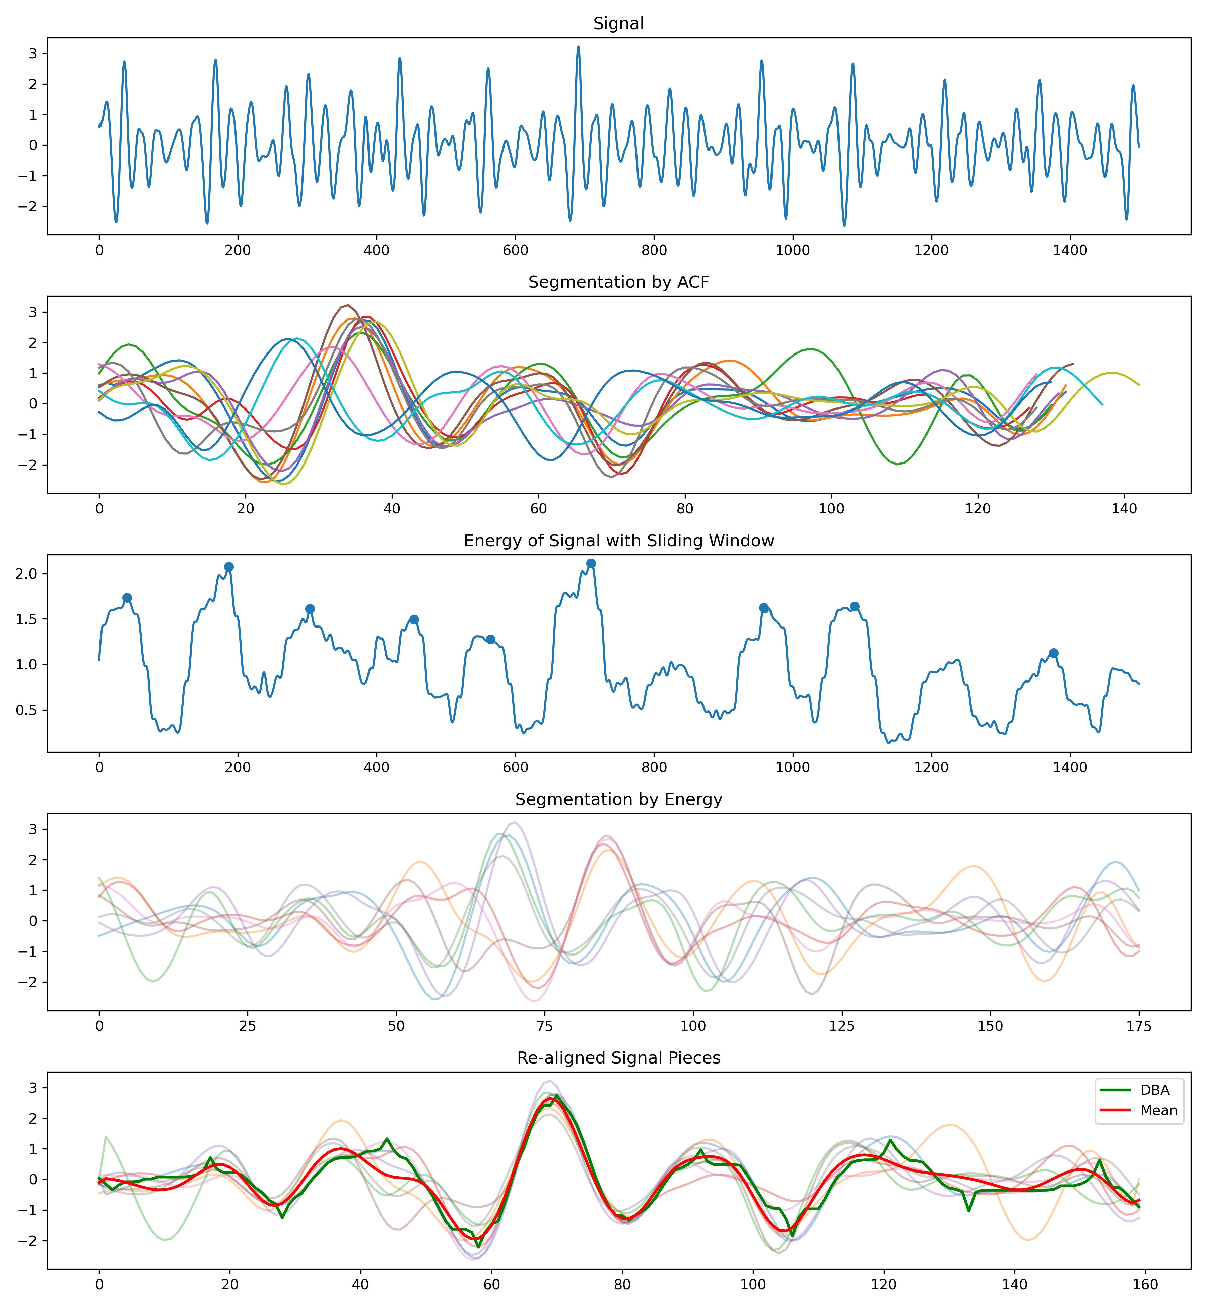
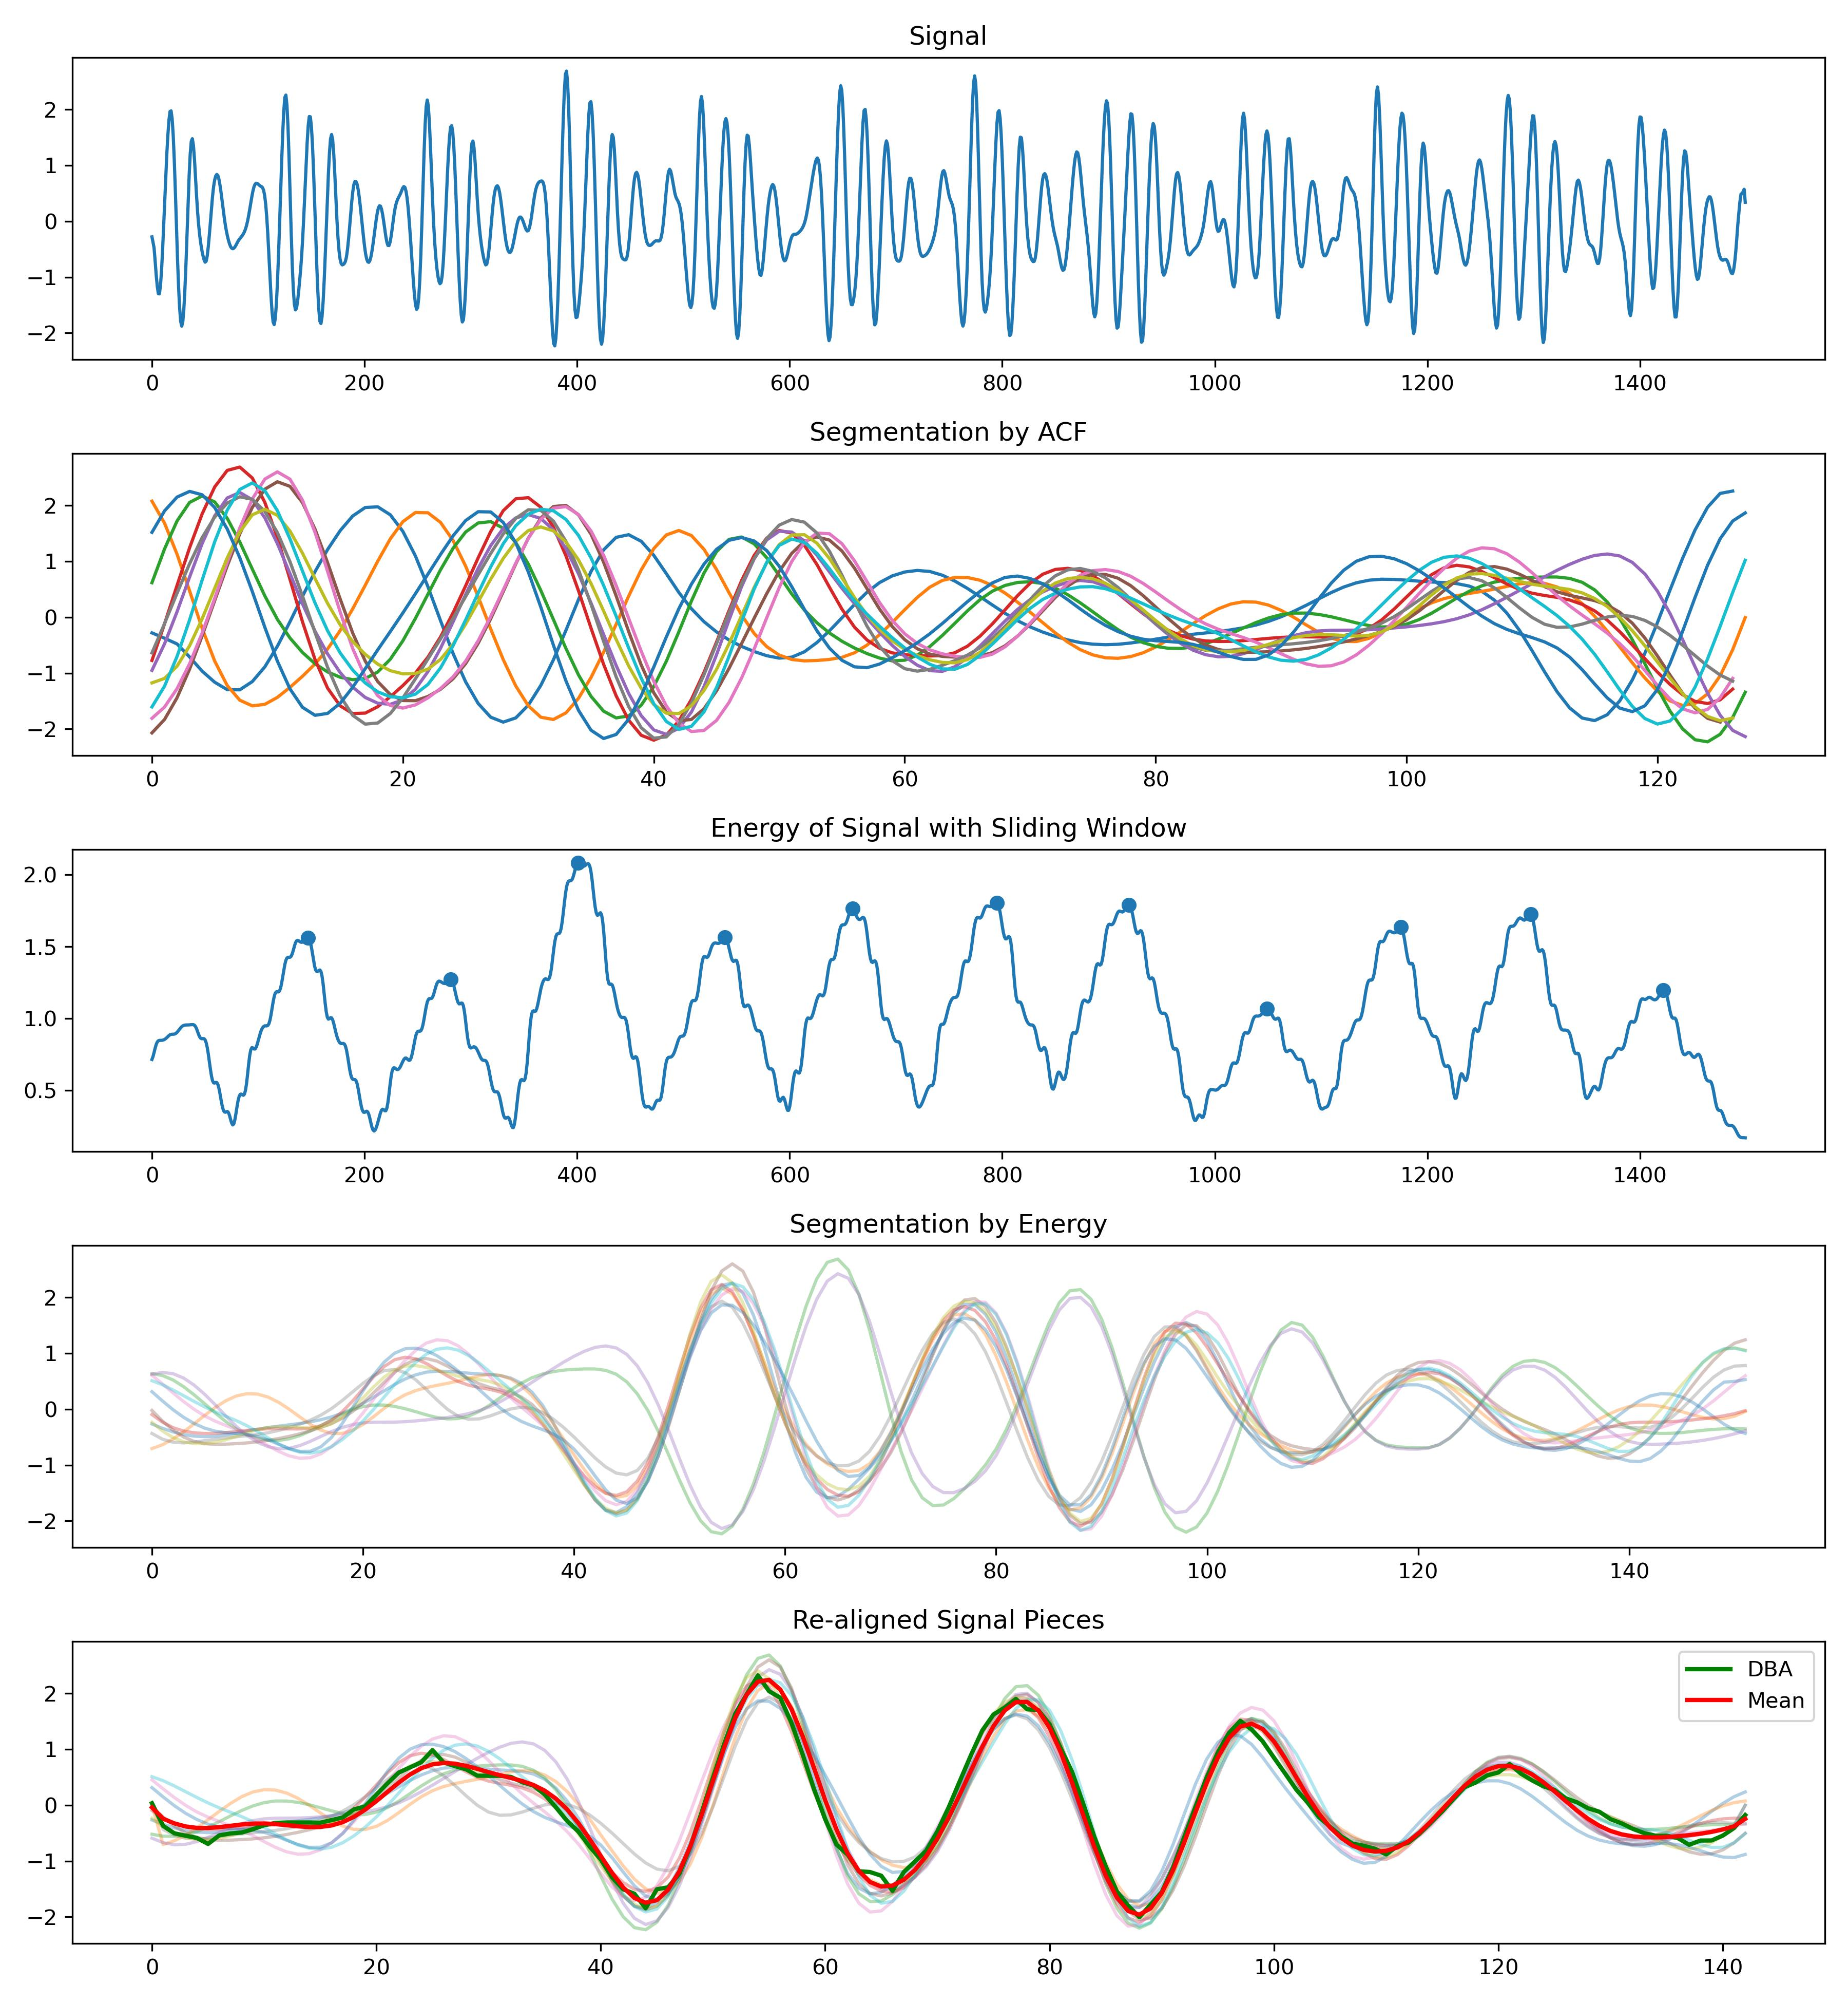
Re-alignment
Preprocessing
Segmentation
Realignment
Template
Feature Extraction
Prediction
More Figures can be found here:
https://github.com/A-Big-Tortoise/Presentation/tree/main/Pics/Segmentation

Slide 11
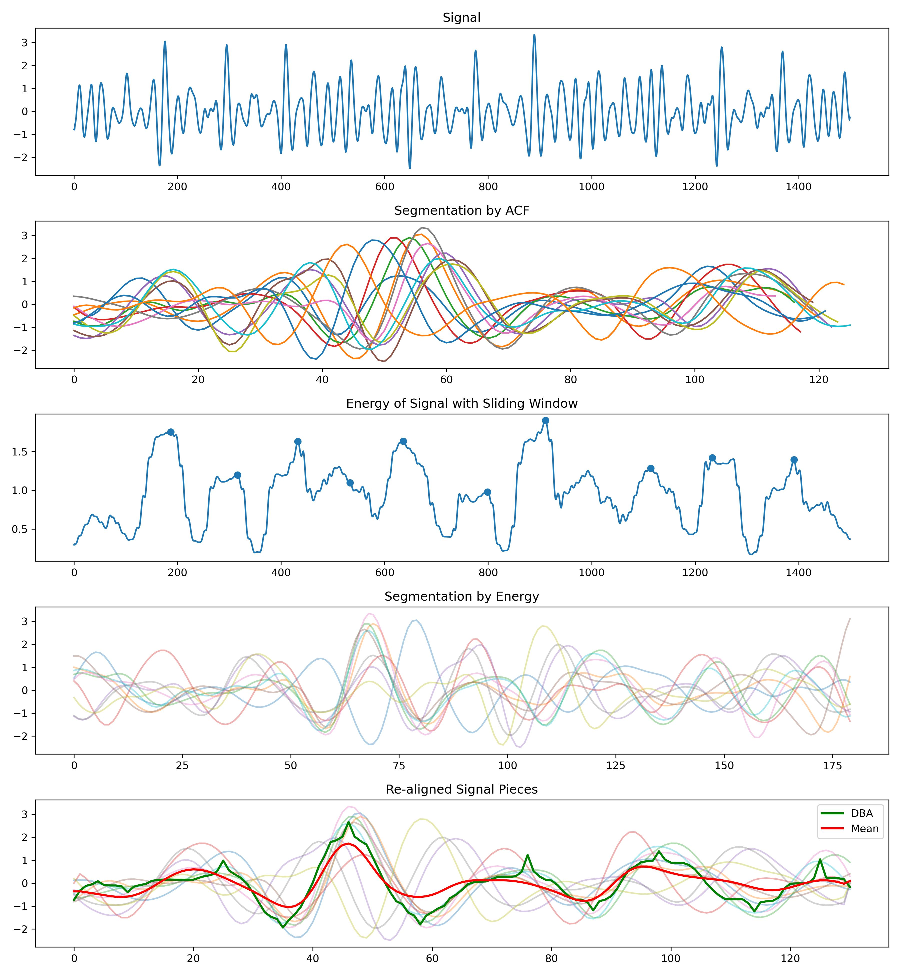
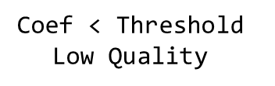
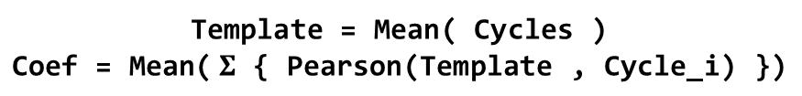
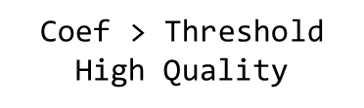
Template and its Quality
Preprocessing
Segmentation
Realignment
Template
Feature Extraction
Prediction
What kind of signal can extract high-quality template?
Is this signal high-quality for the task of extracting a template?
Can we check the quality of signals before obtaining the template?
Yes
No
How to eliminate some bad cycles?
Statistical measurement
Experience-based strategy
If … Else
How to assess whether a template is good or not?
Whether the re-alignment is successful can be used to assess the quality of the template.
Template = Mean( Cycles )
$$\text{Coef}\text{ = }\text{Mean}\text{(} Σ \text{\{ }\text{Pearson}\text{(}\text{Template}\text{ , }\text{Cycle}\text{_}\text{i}\text{) \})}$$
$\text{Coef}$ < Threshold
Low Quality
$\text{Coef}$ > Threshold
High Quality
https://github.com/A-Big-Tortoise/Presentation/tree/main/Pics/QualityAssessment4Template
Notes:
信号的质量进行进一步的筛选，从而确保在信号中能够提取出有效的模板。

Slide 12
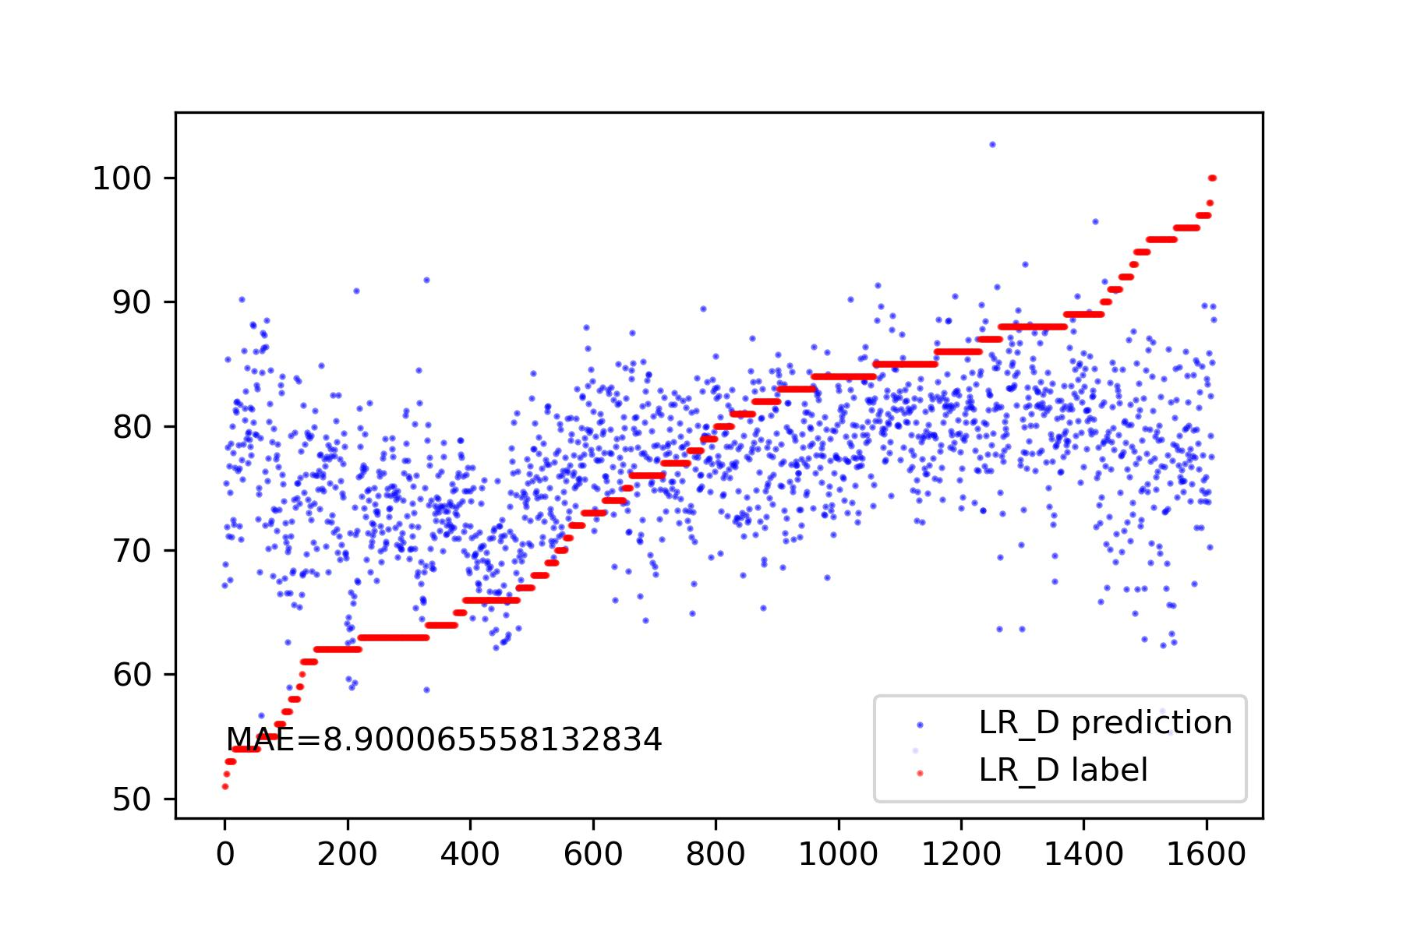
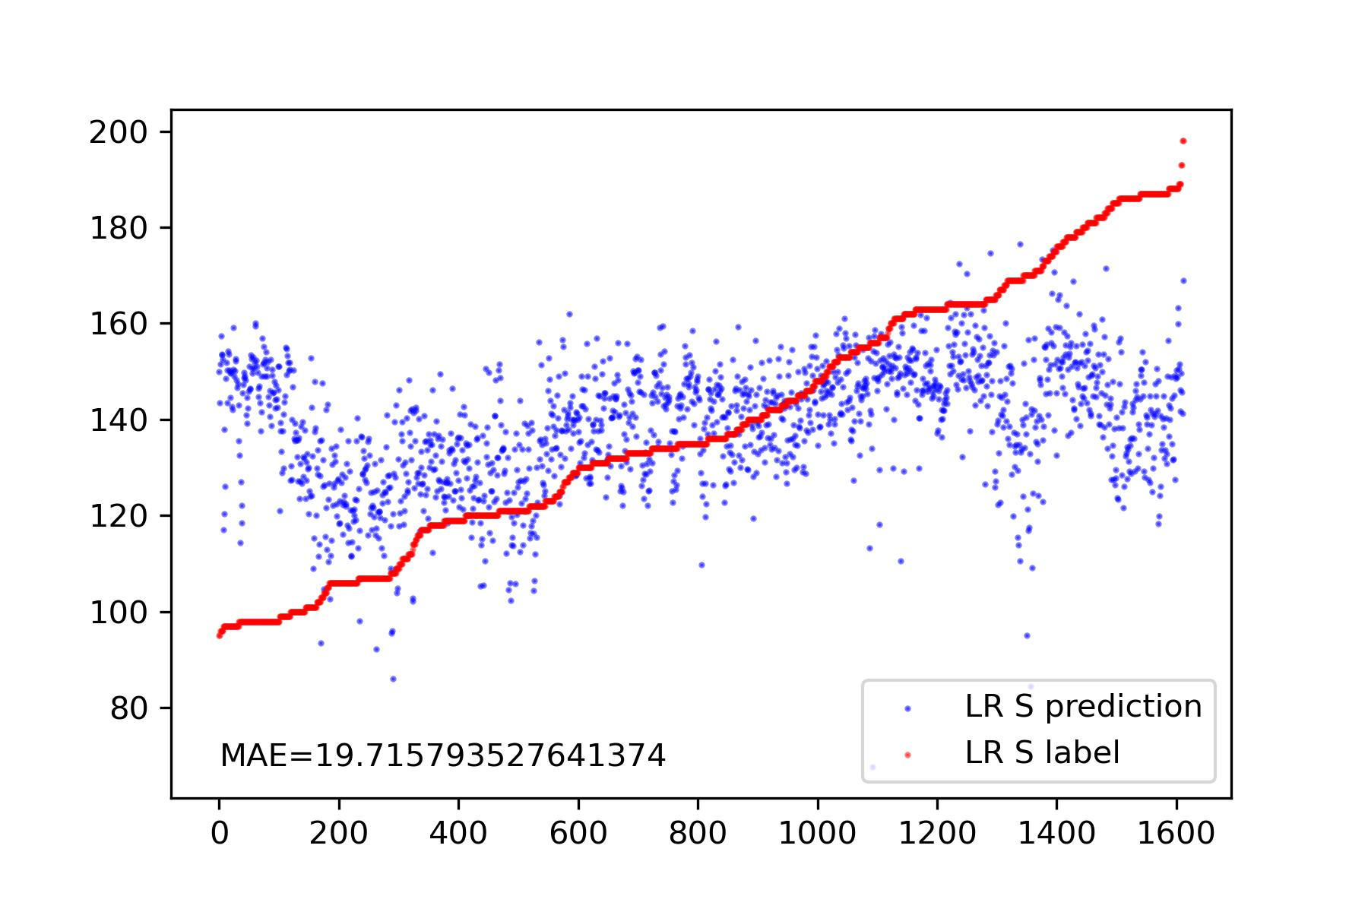
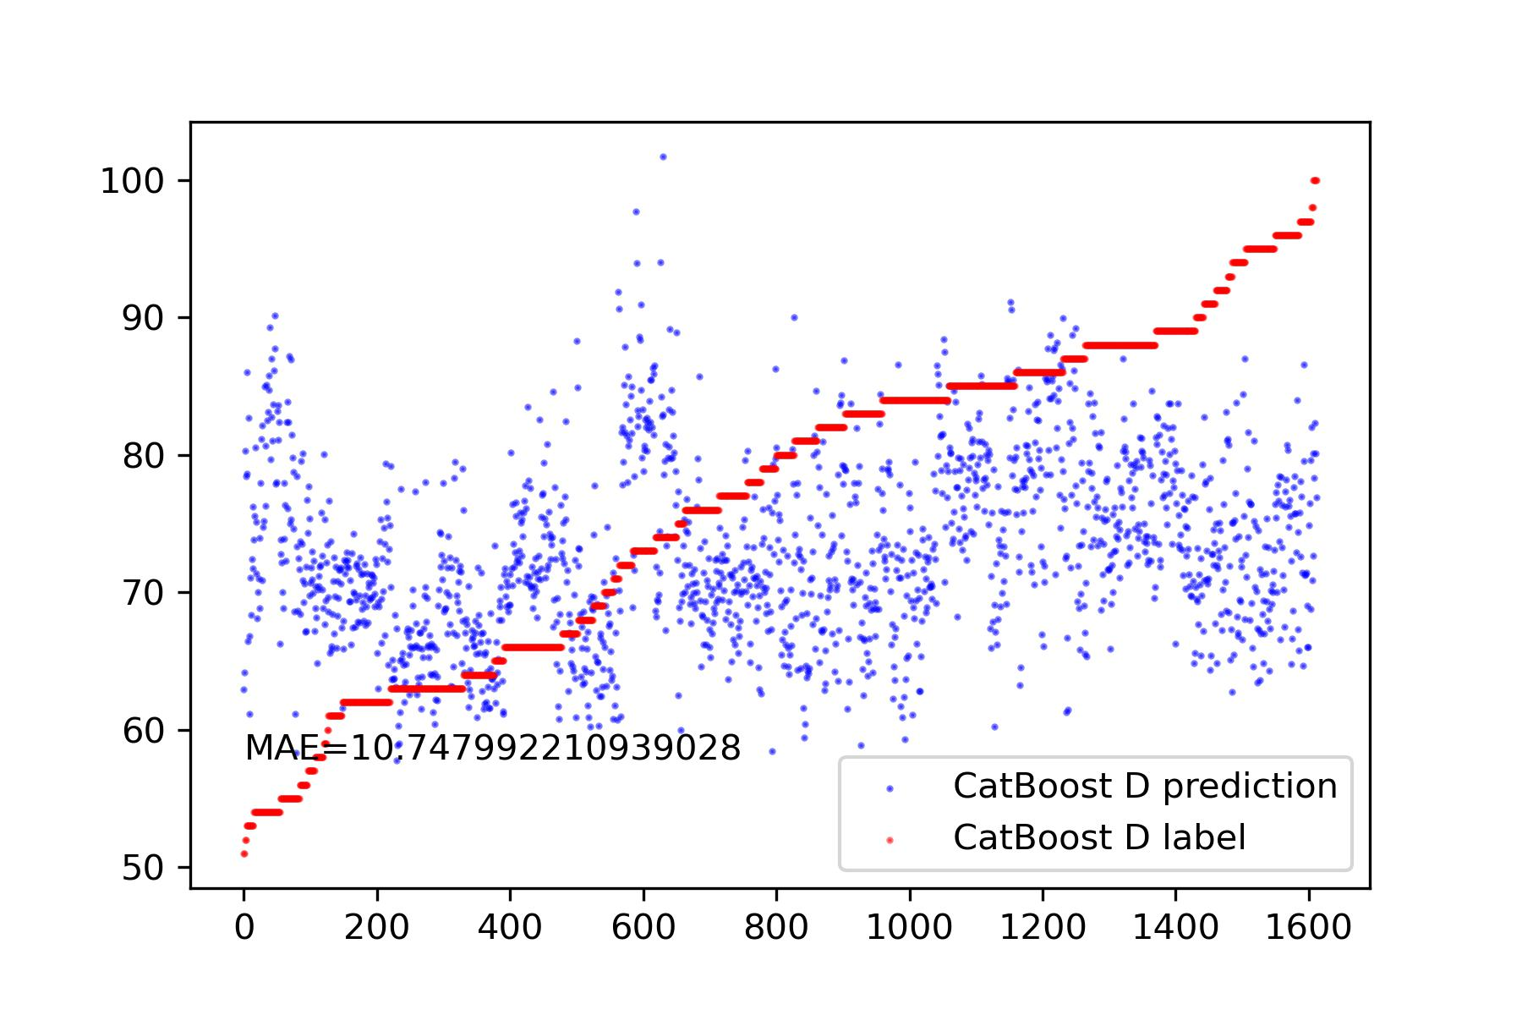
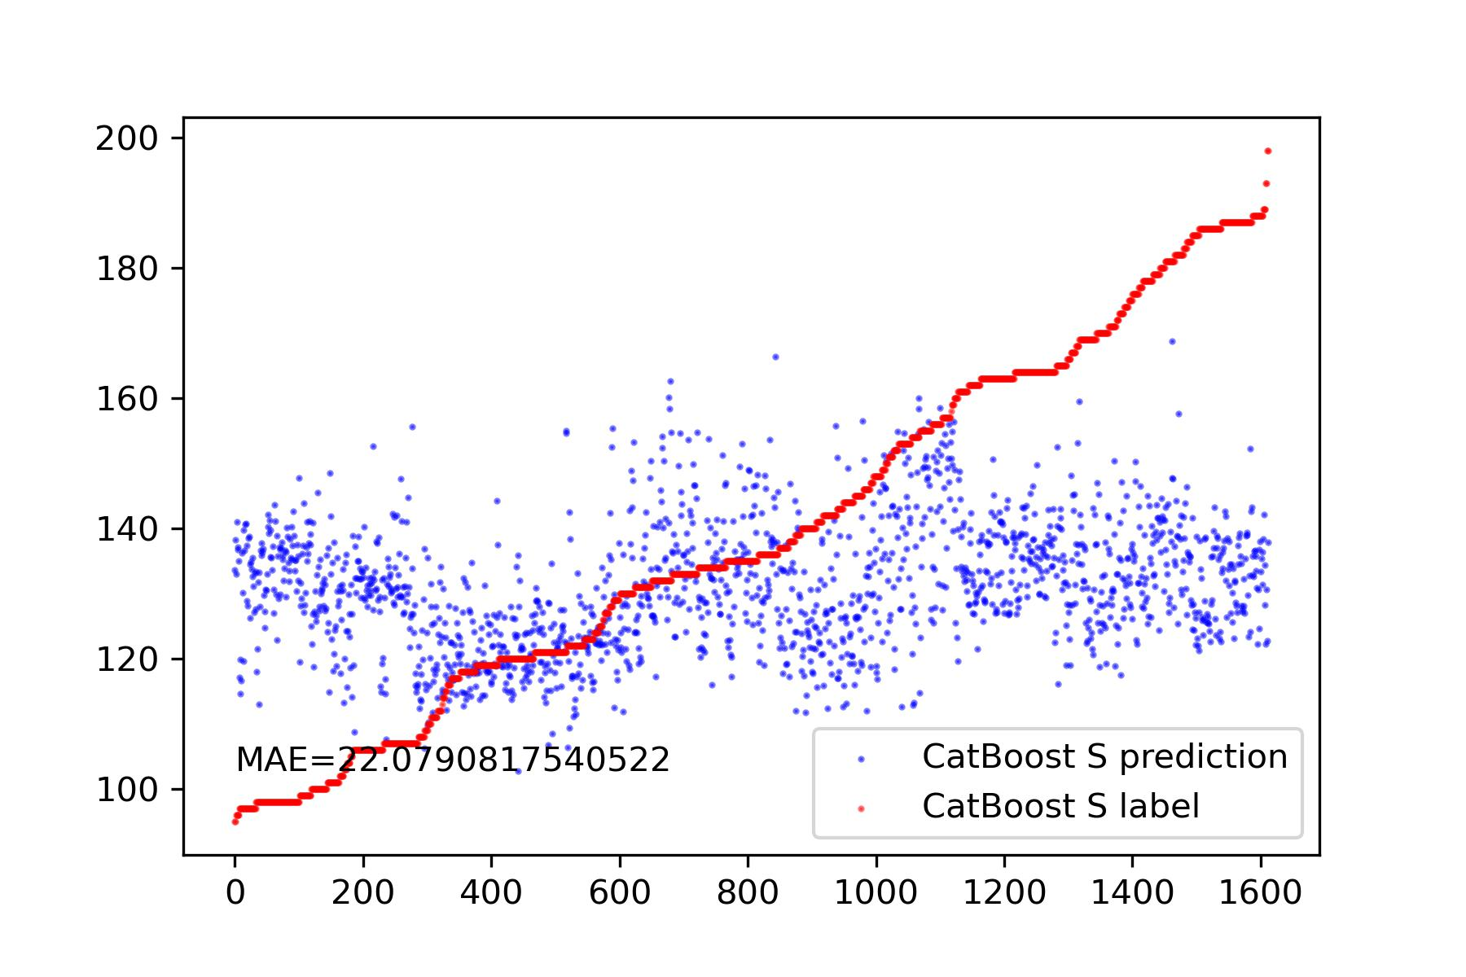
Feature Extraction
Preprocessing
Segmentation
Realignment
Template
Feature Extraction
Prediction
Feature cleaning
Drop NaN
Drop features with very small variance.
Drop features with a correlation lower than 0.2.
Linear Regression
Utilize Tsfresh to extract over 800 features from the template.
CatBoost
Linear Regression
CatBoost

Slide 13
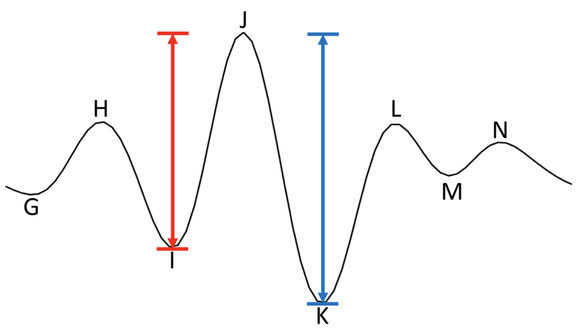
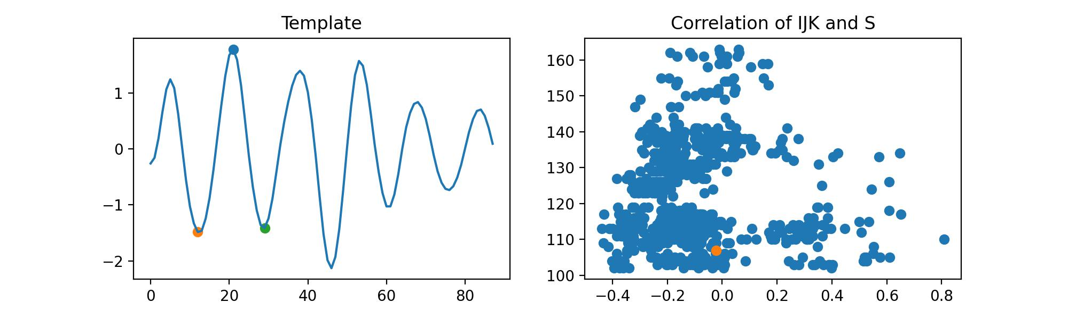
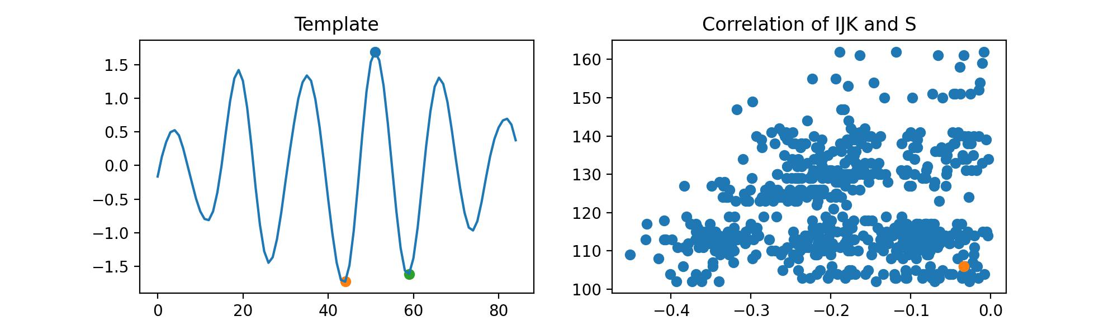
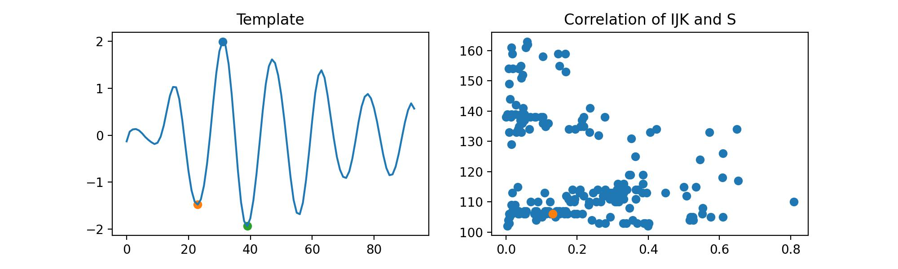
Feature Extraction
Preprocessing
Segmentation
Realignment
Template
Feature Extraction
Prediction
IJK Feature = (JK -IJ)/IJ
IJ < JK
All Situations
IJK Feature Extraction
With the assumption of the biggest peak is J peak.
The relative heights of the I and K peaks are not stable; the majority of cases show that IJ > JK.
IJ > JK
IJ < JK

Slide 14
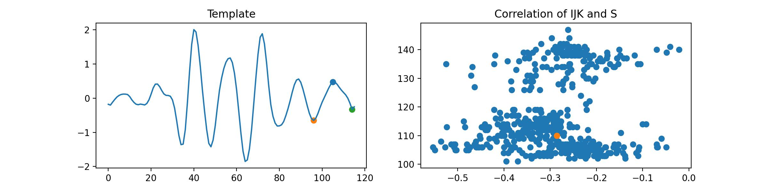


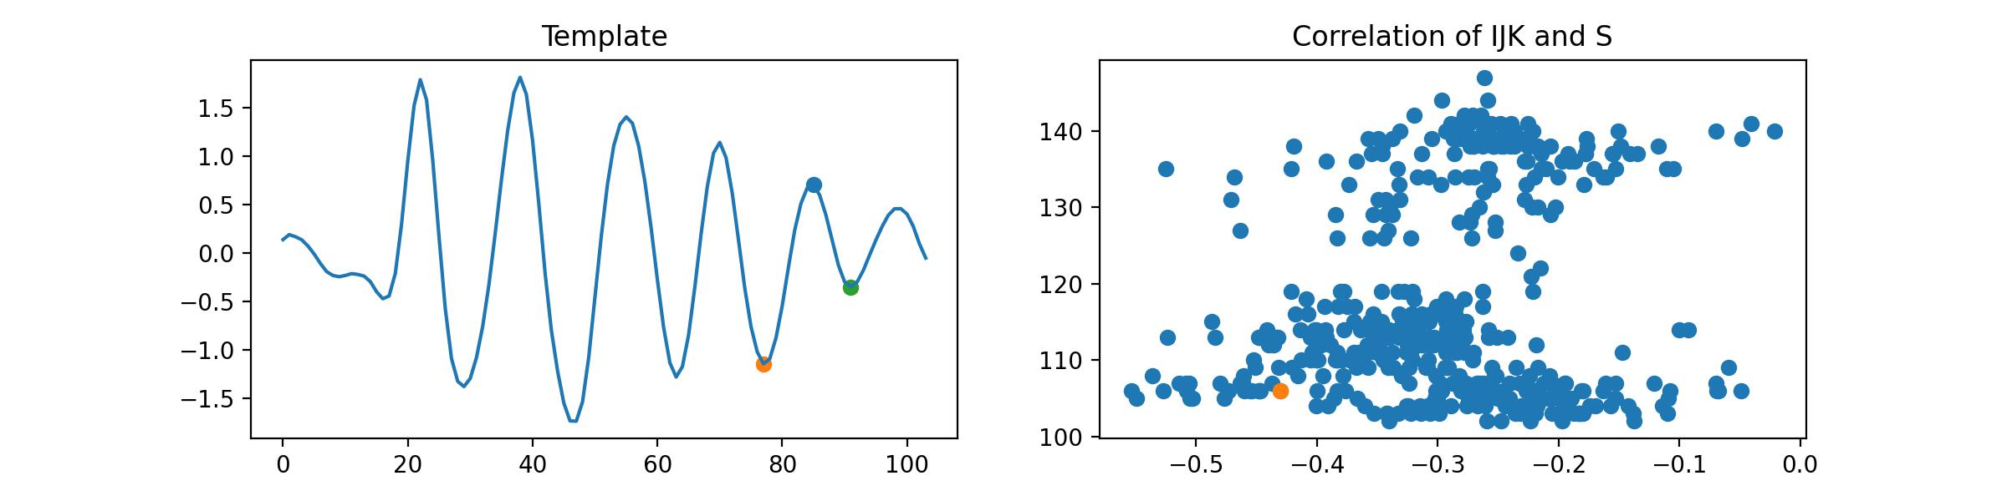




Feature Extraction
Preprocessing
Segmentation
Realignment
Template
Feature Extraction
Prediction

Slide 15
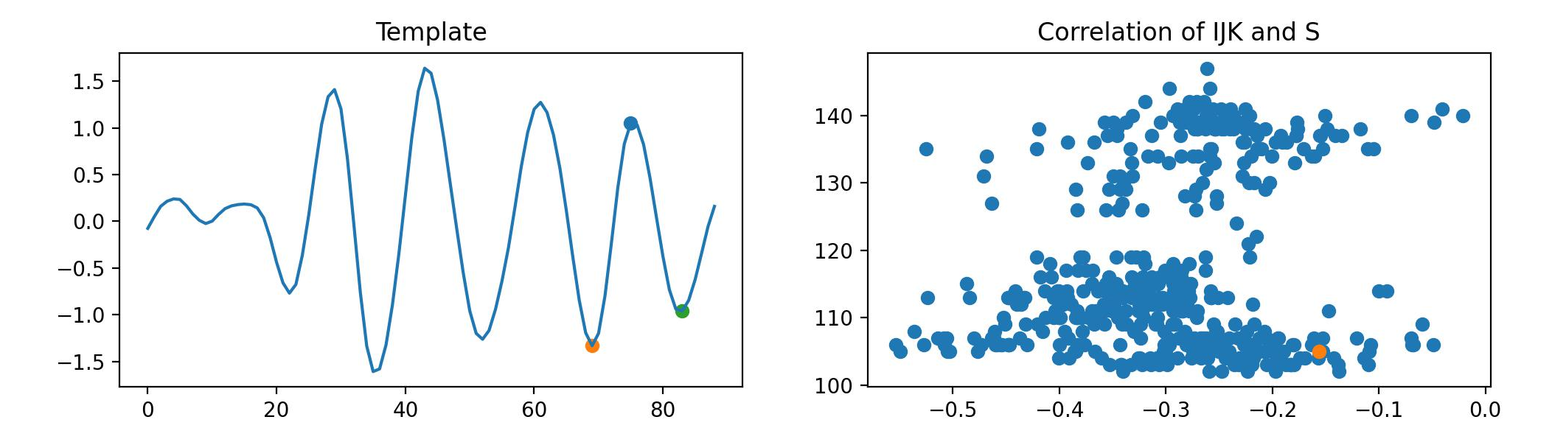
Feature Extraction
Preprocessing
Segmentation
Realignment
Template
Feature Extraction
Prediction
This type of points can be explained with difficulty, mainly due to incomplete template.
Conclusion:
correlation of the currently extracted features is still too unclear, making it unsuitable for prediction.

Slide 16
Part_2

Slide 17
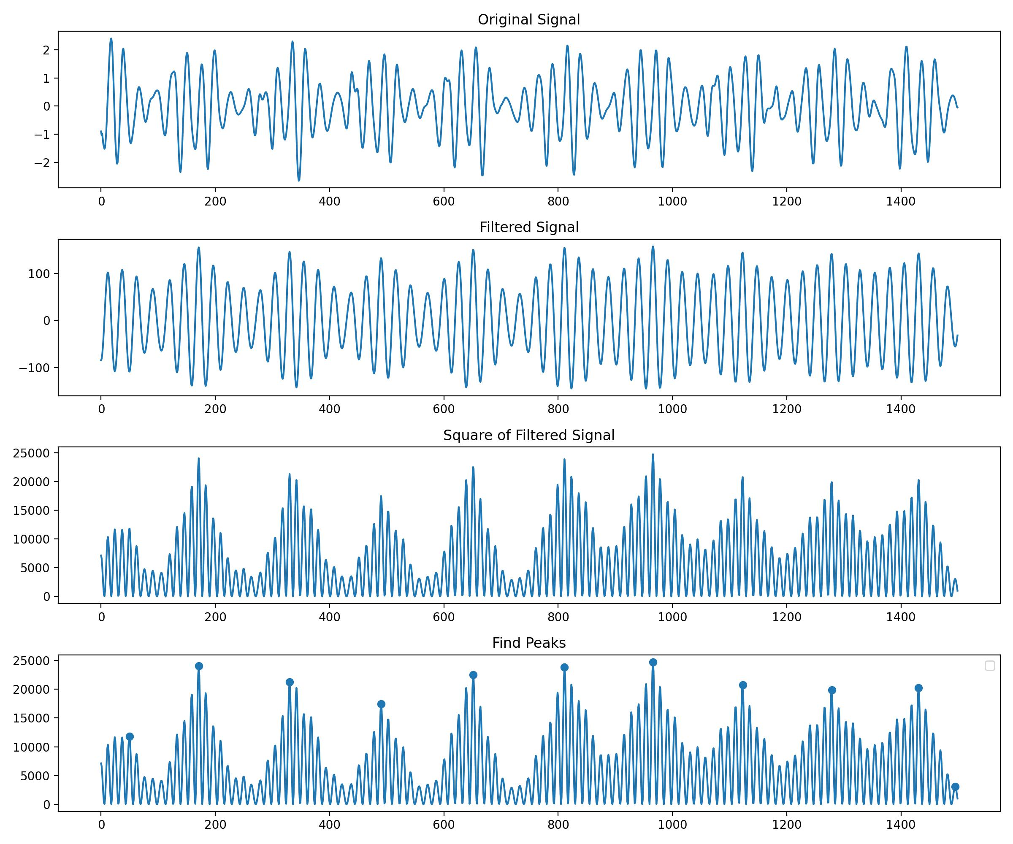
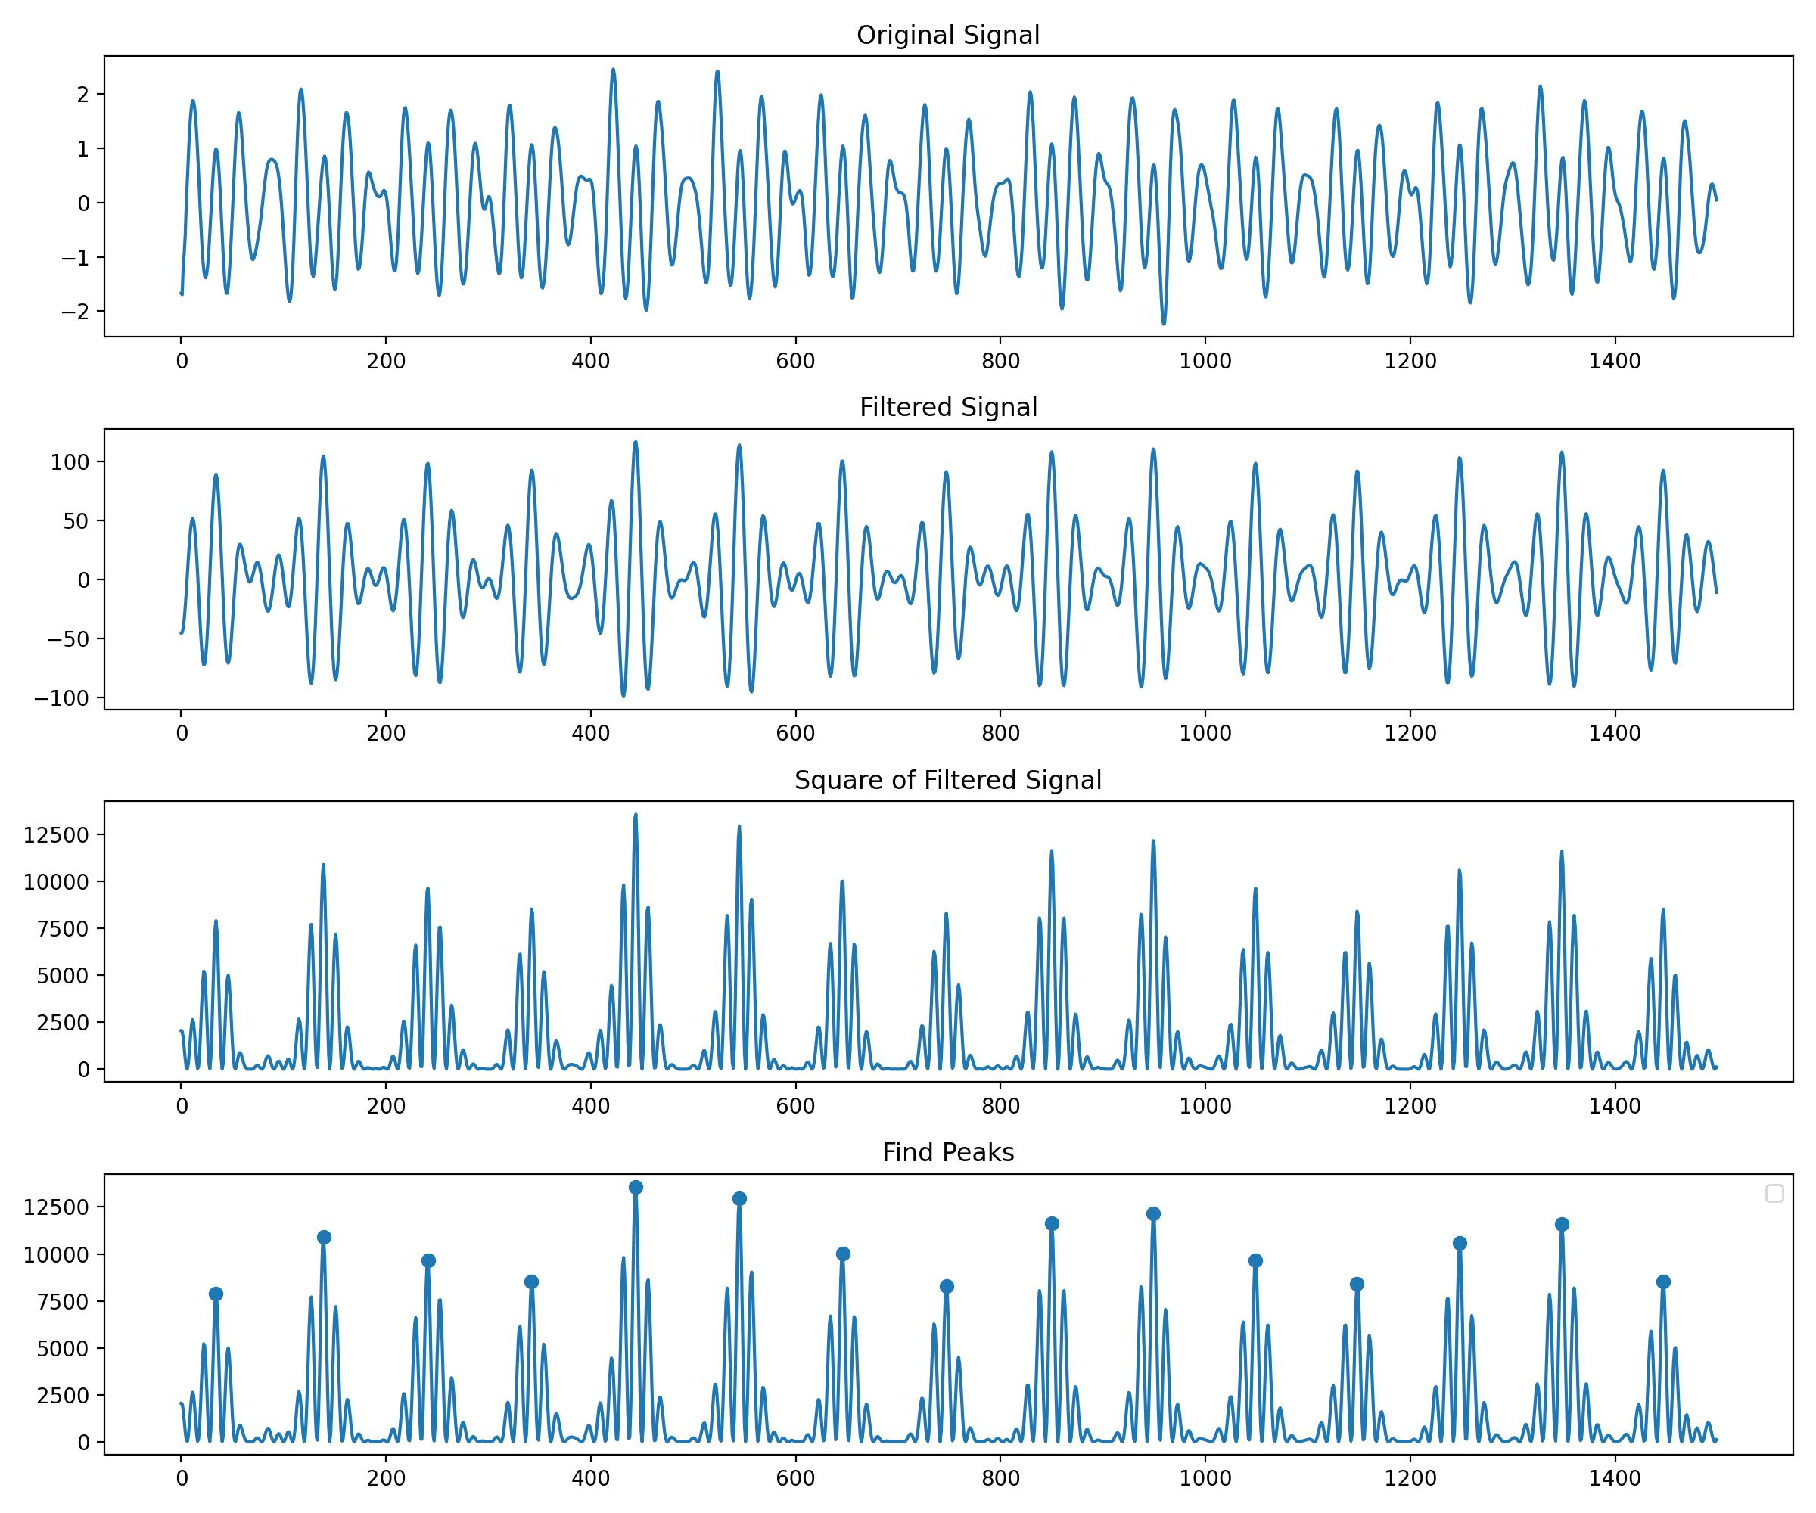
Matched Filter
After applying the matched filter and squaring the result.
The position of the highest peak in a single cycle is very stable. The highest peak in the signal represents the position most closely matched to the template.

Slide 18
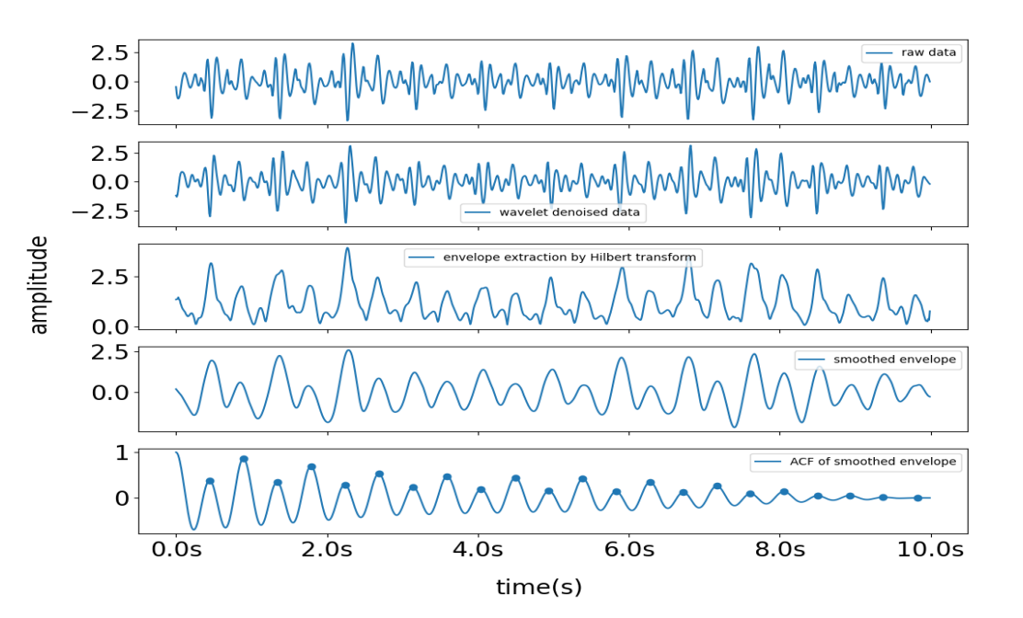
Matched Filter
Material From Yingjian’s Paper
In principle, this method can address issues Yingjian encountered in the paper. It may even help to achieve higher precision in real-time inter-beat interval (IBI) estimation.
I made an initial attempt, but it was not successful. I won't go into the specific reasons here.
However, errors can arise when the incoming signal displays two distinct peaks within a single heartbeat cycle, as illustrated on the right side of fig.9. The first of these peaks is termed the systolic peak, while the second is the diastolic peak.

Slide 19
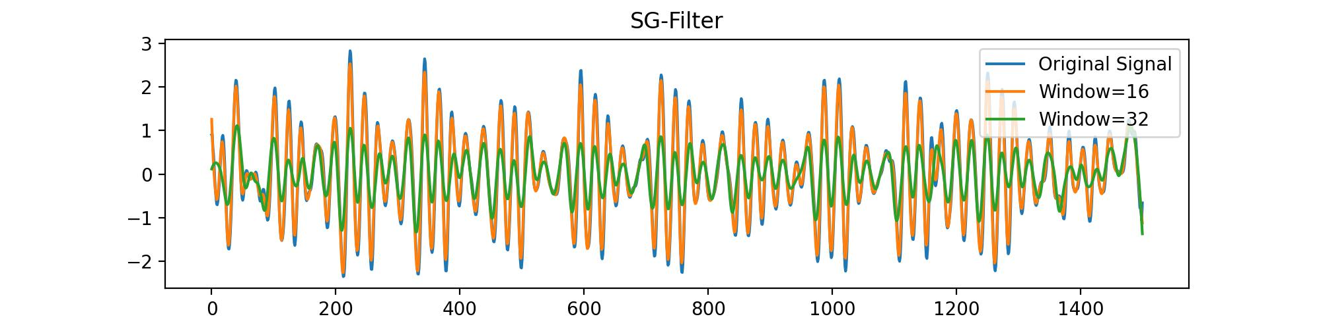
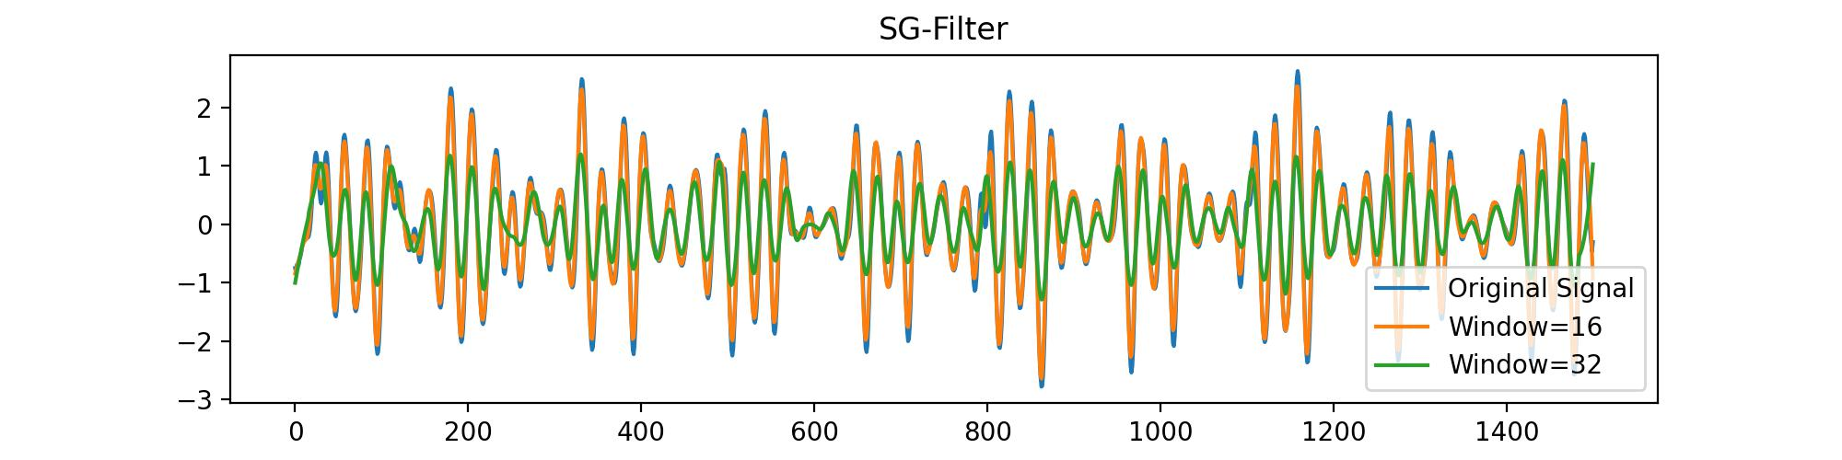
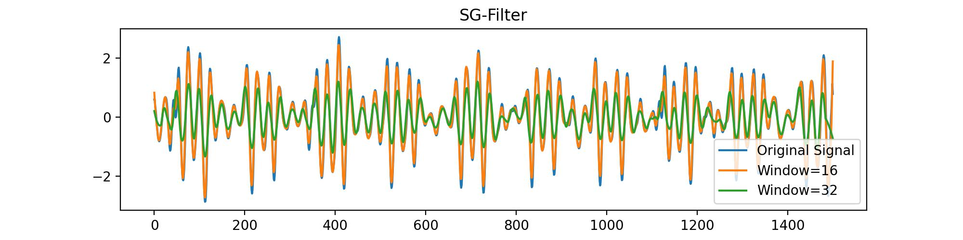
SG Filter
It seems that the SG filter doesn't provide much value; there is hardly any noticeable difference between the original signal and the filtered signal.

Slide 20
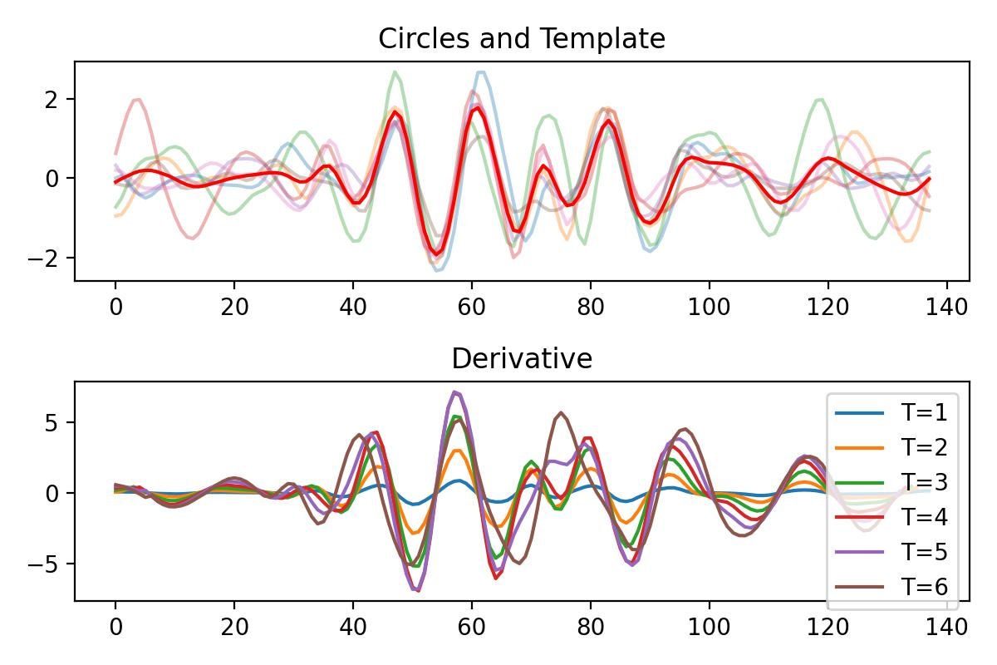
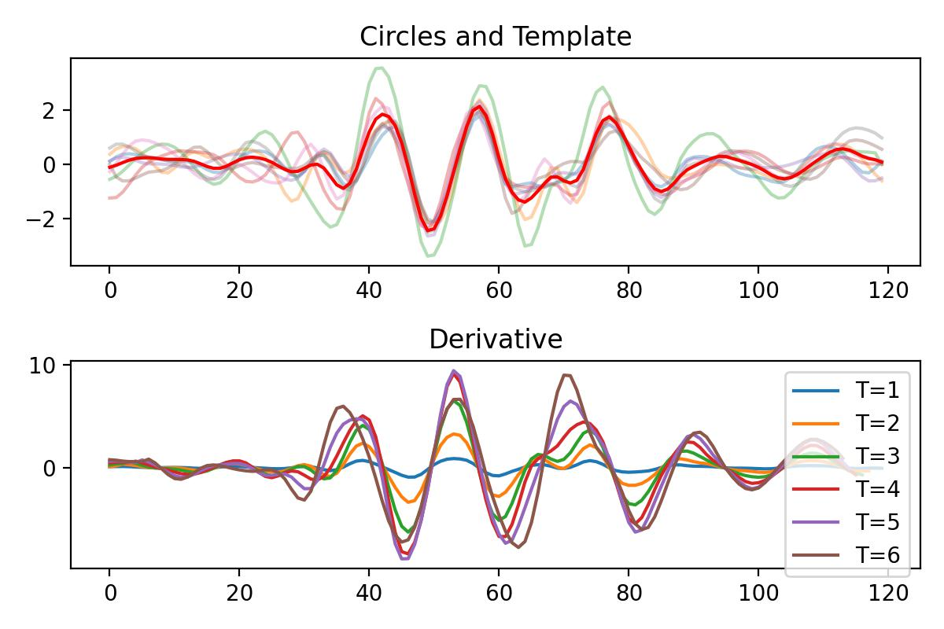
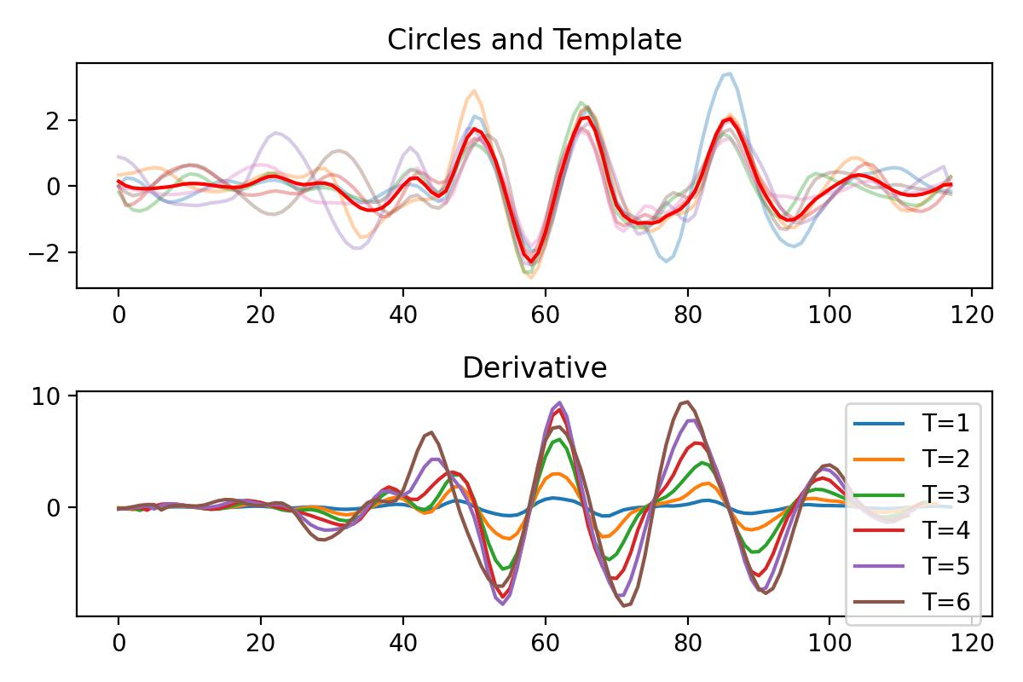
Differentiation
After taking the derivative, the BSG signal becomes more similar to the BCG signal. However, I haven't tried extracting features from the derivative signal yet.

Slide 21
Part_3

Slide 22
Why doesn’t FMM work
Disadvantages of FMM (from the demo code):
We must decompose a single-cycle signal into a large number of components, if we want to focus on smaller peaks.
After decomposition, the relationship between these components becomes chaotic. There is a loss of interpretability in decomposed components.
We can only use FMM to denoise one-circle signal.
But I still don't have a way to measure the effectiveness of the noise reduction methods.

Slide 23
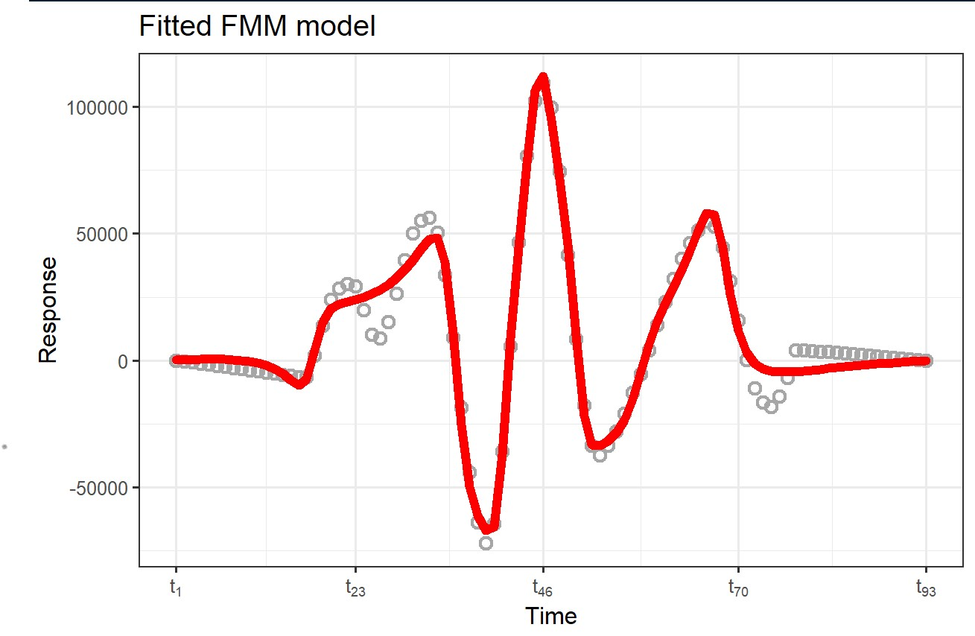
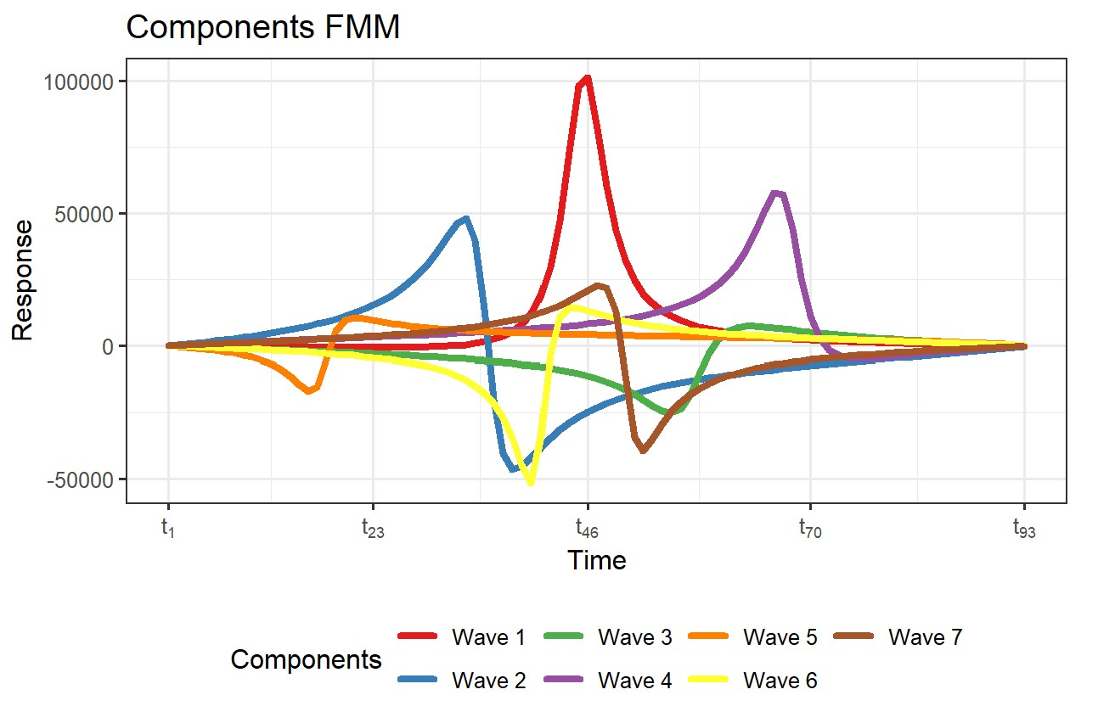
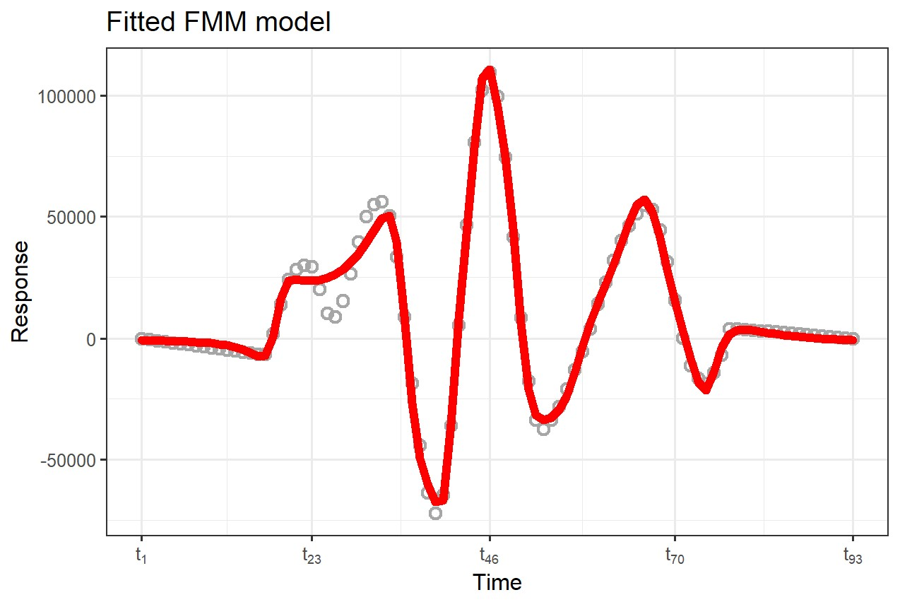
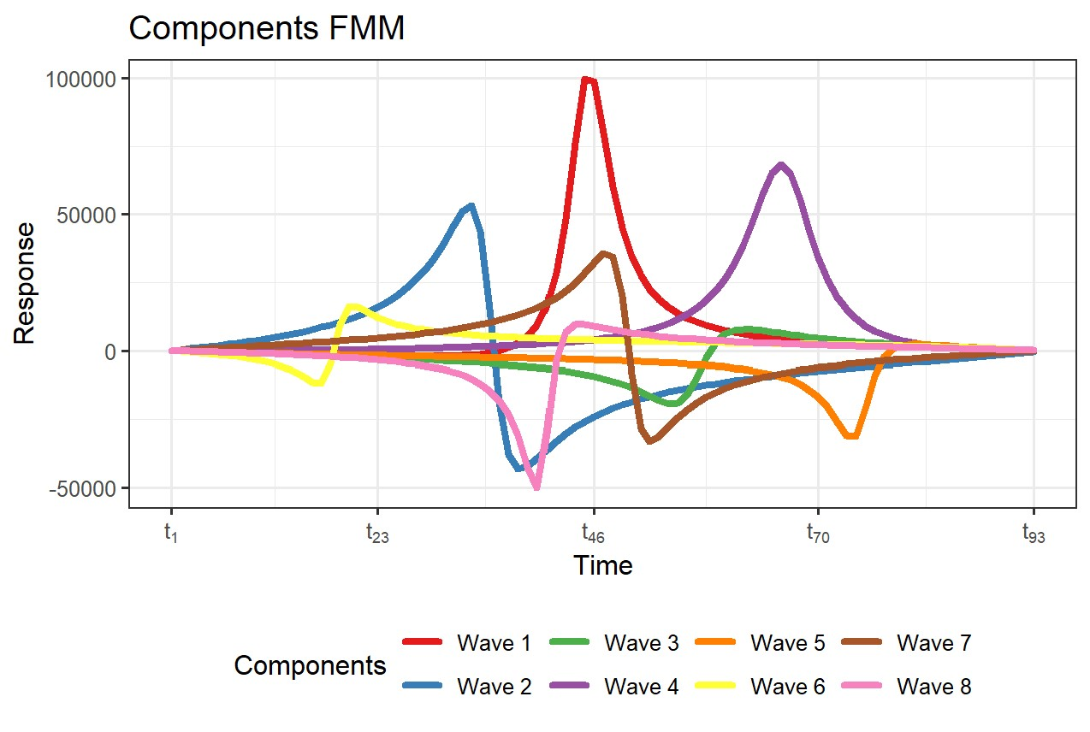
Why doesn’t FMM work
There is almost no interpretability in decomposed components.
We need to decompose a single-cycle signal into a large number of components, if we want to focus on smaller peaks.

Slide 24
Problems
Prof. Xie's views on what I'm currently working on: * In his understanding, my research should lean more towards theory. He suggests referencing statistical signal processing. * He is somewhat against the design process.
What should be the next steps? Should I continue extracting features? Does this feature extraction step require collaboration with Yida?
I previously collaborated with Professor Xie on a paper. Now, I might need to spend some time completing the paper.
Notes:
1. 你的降噪方法，它是最优的，可以数学上证明出来，是无偏的，等等
2.设计流程，你如何说明你设计的流程是有效；仅仅在数据集上测试效果好是没有价值的，没法说明你流程的设计是最优的；总结一下就是说：流程设计不是很general，没有学术价值。他已经不止一次和我说这个事情了
我的观点是这样，
首先，我认为，如果能从理论上证明最优，那必定是最好的。这个可能是最终目标，但是作为我毕业论文的目标感觉不太合适.
这个事情呢，谢老师已经说了好几次了，所以统计信号处理也要学一些，我把它作为对照实验补充进去。
但是呢，我和他解释了好几遍了，谢老师他总是认为我在做降噪，他不是特别了解我们在干什么。而且，他本身没有学过统计信号处理，只有一个很笼统的印象。在这种情况下，他如果要求换方向，我是不能接受的。
The acceptance of this paper is crucial for the nomination of an outstanding graduation project at the provincial level.

Slide 25
Thanks!

